Slide 1
A Lifestyle Medicine Approach to Pediatric Obesity in the Medical Home
QTIP Spring Workshop April 21, 2022
Erin L Brackbill, MD, FAAP, dipABLM
erin.brackbill@prismahealth.org

Slide 2
I have no disclosures

Slide 3
OBJECTIVES
Why Lifestyle Medicine?
Understand the background and application of our office flow algorithm
What is Lifestyle Medicine?
Learn key LM concepts that are easily applied in practice
Importance of stage of change and motivational interviewing
The basics of whole food, plant-based nutrition
“Synergy” of the 6 pillars
Tailoring your Approach
Discover ways to integrate new ideas/approaches in a busy practice

Slide 4
The Challenge
In adults, lifestyle factors (behaviors) account for
80-90% of heart disease and diabetes
1/3 of cancers
1/2 of premature deaths
19.3% of US children are obese, 35.4% are overweight/obese combined
Rates of obesity doubled during the covid pandemic
Lifestyle factors are main driver of obesity in children
Most children with obesity have at least 1 comorbid condition
Notes:
At a society level…
Pediatricians are now managing more chronic disease than ever before
It should be alarming that Type 2 Diabetes is no longer called “adult onset diabetes” because it’s now so common in pediatrics.
2015 NEJM study showed that 30-50% of children with obesity carry at least 1 cardiometabolic risk factor, increasing in number with the increasing severity of obesity. This is chronic disease on chronic disease.

Slide 5
Challenges in Practice
Many practices lack a consistent approach among providers
Obesity is a very complex chronic disease
time consuming visits
physical and mental health
provider bias
patient barriers *
lack of training in behavior change counseling and nutrition education

Slide 6
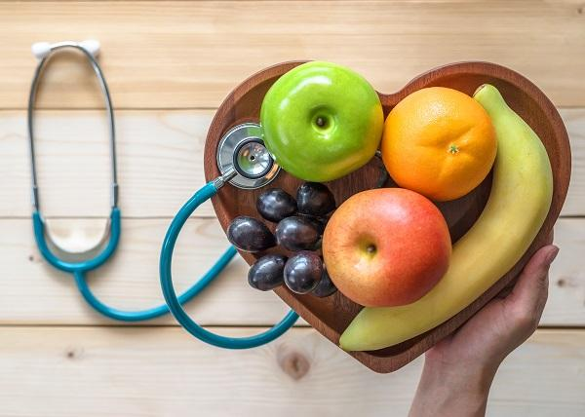
Guiding Evidence-Based Principles to our Approach
Obesity must be viewed as a complex, chronic disease
The medical home is the most effective setting to manage chronic disease
Motivational Interviewing is effective in children and families with obesity
Lifestyle Medicine provides a comprehensive model for prevention and treatment of chronic disease and recognizes the social and emotional issues impacting obesity and other chronic diseases
Notes:
At Center for Pediatric Medicine we have been working hard since 2019 to address these challenges from a preventive and treatment standpoint in the patients and families we serve. Little did we know when we started in 2019 how MUCH we would need this with the rates of obesity skyrocketing during the Covid Pandemic.

Slide 7
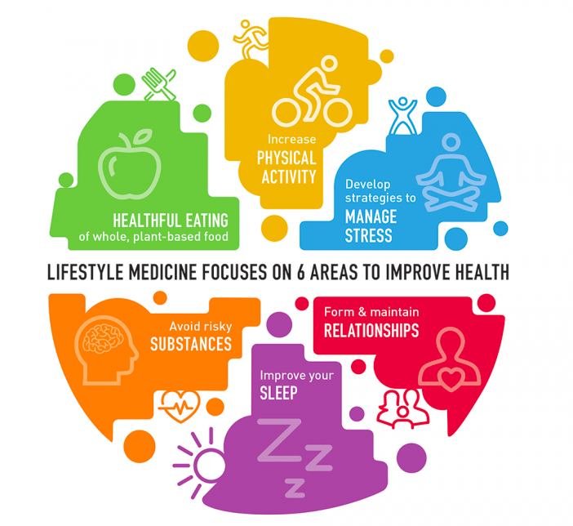
What IS Lifestyle Medicine?
Lifestyle Medicine involves the use of evidence-based, therapeutic approaches to prevent, treat, and often reverse chronic disease by replacing unhealthy behaviors with positive ones.
Almost all clinical practice guidelines for the top chronic diseases support lifestyle as the first line of treatment.
www.lifestylemedicine.org

Slide 8
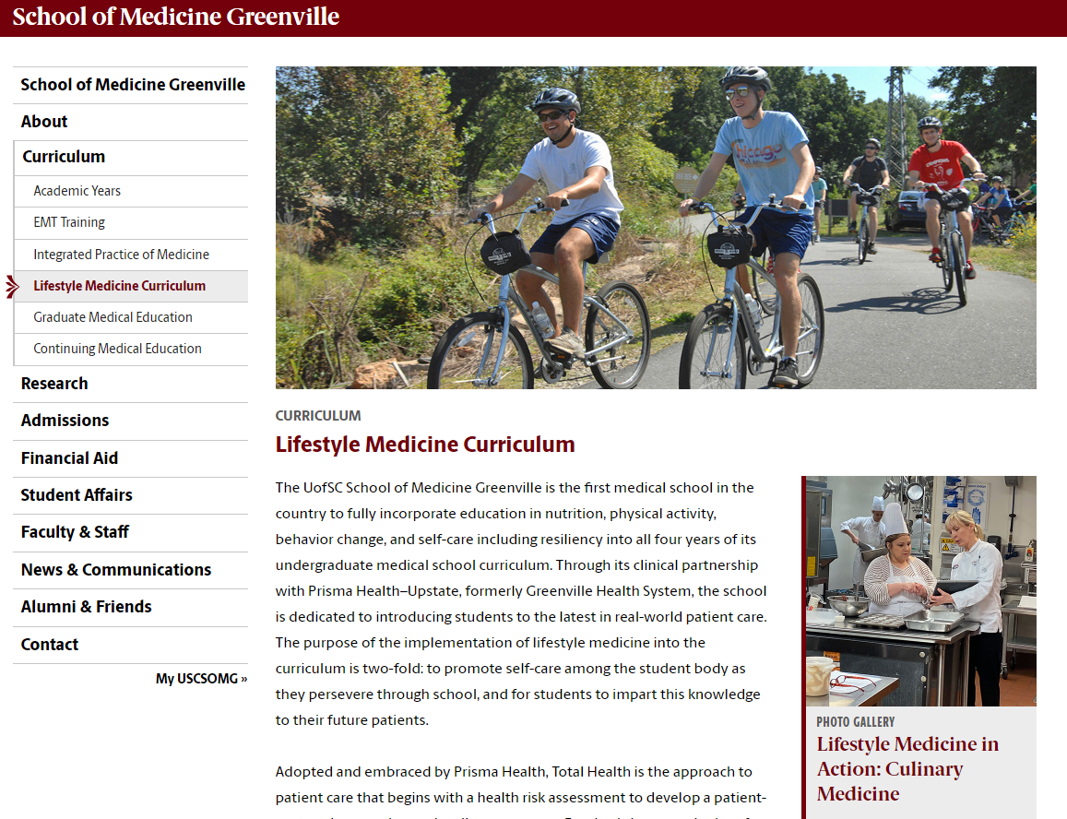
Lifestyle Medicine Incorporated Into Training
Notes:
One of the 1st 2 Med Schools in the Country to incorporate LM across the curriculum for all 4 years. Prisma Health Family Residency program has LM informally incorporated across the curriculum with ABLM certified attendings leading the way. We are currently building and incorporating LM across the curriculum in our Prisma Pediatric Residency Program.
For those who are finished with training, LM Fills gaps for anyone wanting to learn and follow the evidence base in these 6 areas. Physicians surveyed typically report they are not confident in behavioral change counseling or the evidence for lifestyle change particularly nutrition.
— Fastest Growing Medical Subspecialty. It’s a certification that is open to providers who are already board certified for at least 2 years by the american medical board as a generalist or specialist.
—The ACLM started in 2004, The ABLM offered it’s first board certification exam in 2017. It has been a GLOBAL collaboration from the beginning.. We have had several practices interested in certification of at least one of their team since we started this QTIP initiative last year and it’s so exciting!

Slide 9
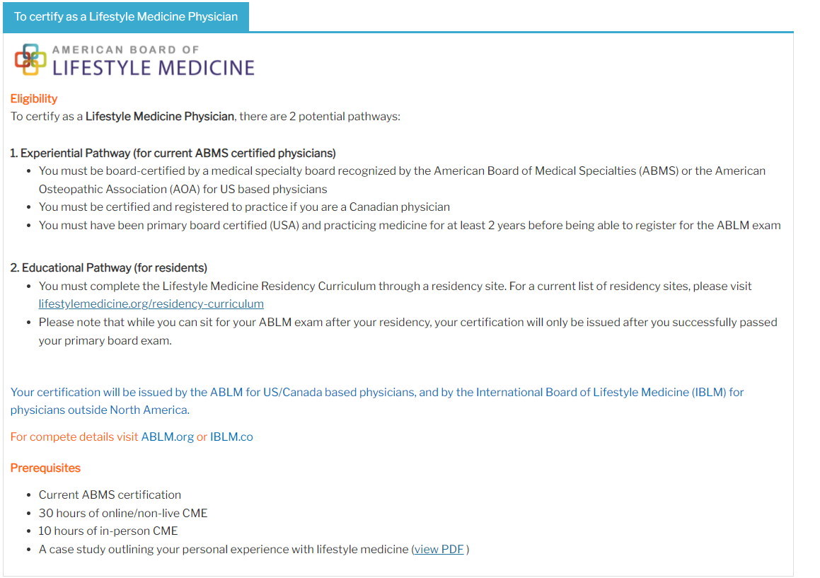
Lifestyle Medicine Certification
Lifestylemedicine.org
Click on “certification”
Notes:
One of the 1st 2 Med Schools in the Country to incorporate LM across the curriculum for all 4 years. Prisma Health Family Residency program has LM informally incorporated across the curriculum with ABLM certified attendings leading the way. We are currently building and incorporating LM across the curriculum in our Prisma Pediatric Residency Program.
For those who are finished with training, LM Fills gaps for anyone wanting to learn and follow the evidence base in these 6 areas. Physicians surveyed typically report they are not confident in behavioral change counseling or the evidence for lifestyle change particularly nutrition.
— Fastest Growing Medical Subspecialty. It’s a certification that is open to providers who are already board certified for at least 2 years by the american medical board as a generalist or specialist.
—The ACLM started in 2004, The ABLM offered it’s first board certification exam in 2017. It has been a GLOBAL collaboration from the beginning.. We have had several practices interested in certification of at least one of their team since we started this QTIP initiative last year and it’s so exciting!

Slide 10
Our Approach Centers Around 3 Main Ideas
FLOW An office flow for pts with BMI >85% to improve consistency and follow up
STAGE OF CHANGE/USE OF MI An approach is tailored to the patient’s stage of change and uses motivational interviewing to help resolve ambivalence
LIFESTYLE MEDICINE Our approach uses Lifestyle Medicine principles as a primary resource in 6 main areas of healthy habits. Also a great resource for behavioral change and nutrition education!

Slide 11
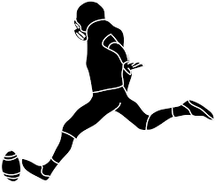
A LM Approach to Pediatric Obesity
Part 1: Predictable Flow
Part 1: Predictable Flow
Part 2: Stage of Change/MI
Part 3: LM Principles
BMI pattern is noticed (usually WCC). Mention this with sensitivity and concern. Ask permission to discuss.
Notice comorbidities and FH.
Get a sense of where they are with it
Then ASK if they are interested in follow up.
⭐ Order obesity-related labs if indicated ⭐
Notes:
3) Awareness, interest, readiness?
4) If YES, agree on a separate appointment (intake). If NOT, gently make connections to related health issues and ASK permission to revisit this.

Slide 12
Role play
Also see “Slide 12 Video – Ready to Change” on website
https://youtu.be/fG_9d0Q-g4E

Slide 13
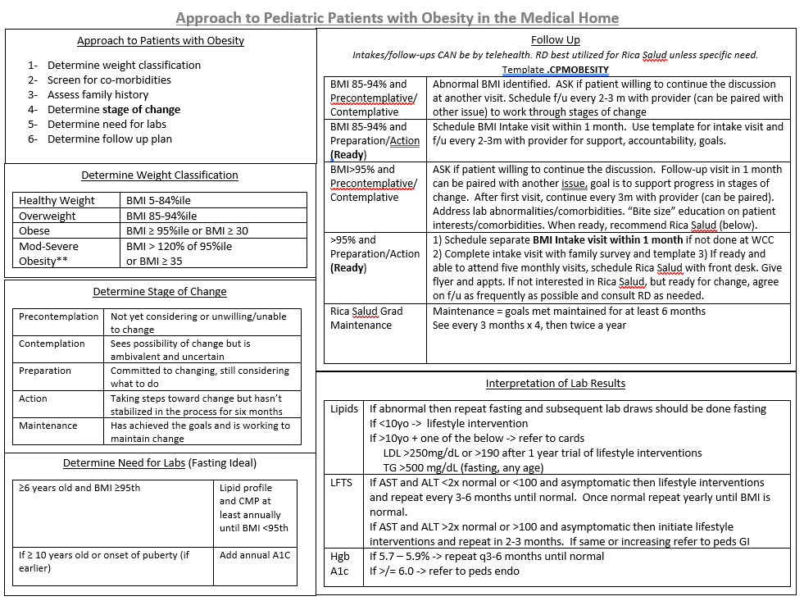

Slide 15
Stage of Change and Follow Up
BMI 85-94% (overweight) BMI >95% (obese)
Not Ready Not Ready
Ready *Ready
https://youtu.be/fG_9d0Q-g4E

Slide 17
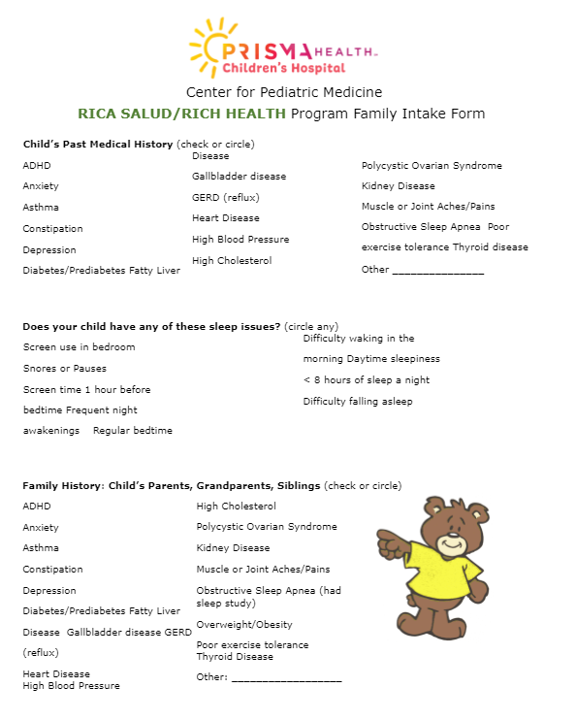
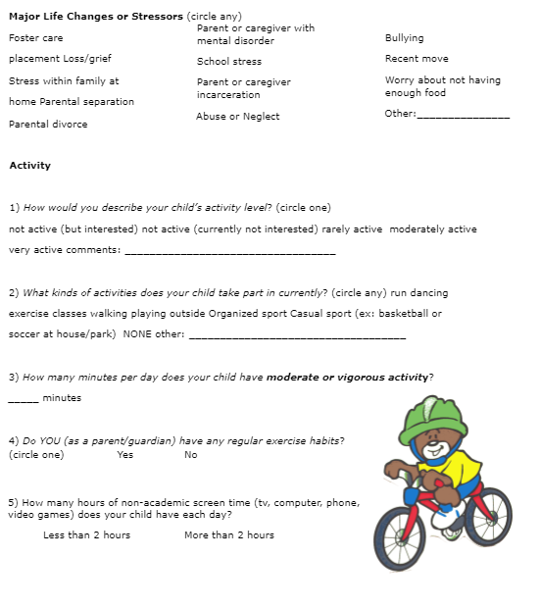
Intake Visit: Family Survey
Relevant PMH, FH
Sleep Issues
Stressors
Activity
+ Diet Hx in template
+Refer to their most recent SWYC Social and Emotional Screeners
Notes:
SWYC (social and well being of young children) comprehensive screener

Slide 18
ACEs and Social Determinants of Health
Maternal obesity and chronic stress can cause gene dysregulation in children, changing the microbiome; increasing inflammation, cortisol and body fat.
With ACEs, developing brains and the neuroendocrine system are affected*
Food insecurity is associated with hoarding, overeating
It’s been shown that children with neurodevelopmental delays are at greater risk for overweight/obesity if they have the risk factors of poverty and ACEs (Mehari et al. Maternal Child Health 2020. 180 to DB clinic)
“Epigenetics”
Notes:
We underestimate the complex relationship between obesity and trauma (ACEs) and obesity and the social determinants of health. These issues extend beyond habits and emotional eating.
–Structural brain differences are found in the areas of the brain linked to appetite control. Increased stress raises cortisol release, increases insulin resistance, alters satiety. Food scarcity is associated with hoarding, overeating.
–The field of study called Epigenetics revolves around this complex interplay between our genes and our environmental triggers

Slide 19
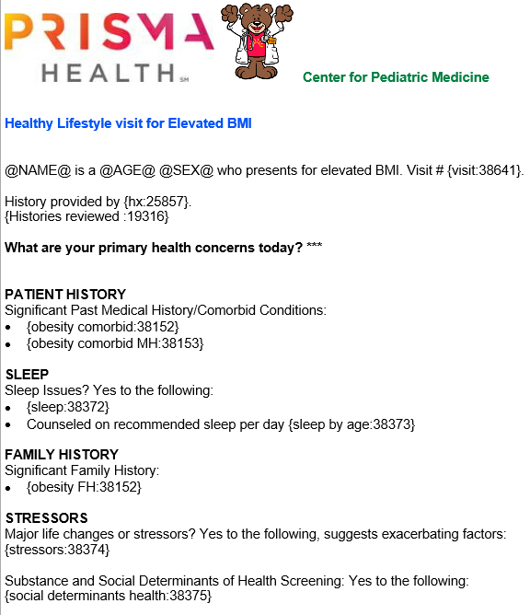
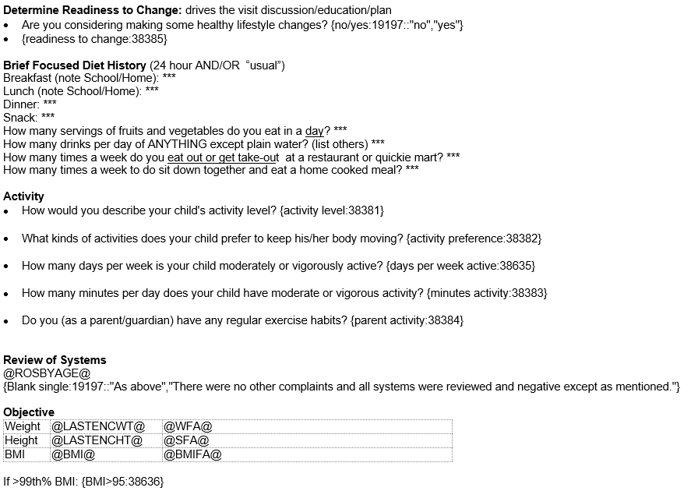
This Photo by Unknown Author is licensed under CC BY
Notes:
Our template has drop downs to remind a provider of the recommendations in different categories

Slide 20
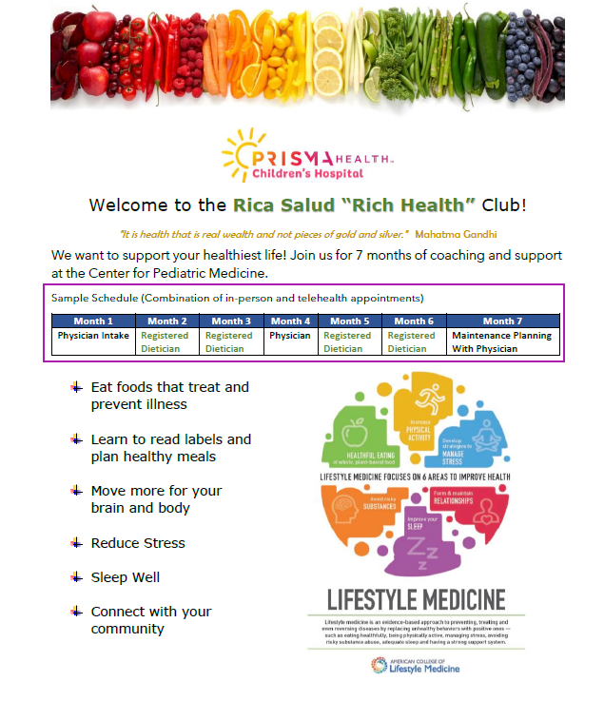
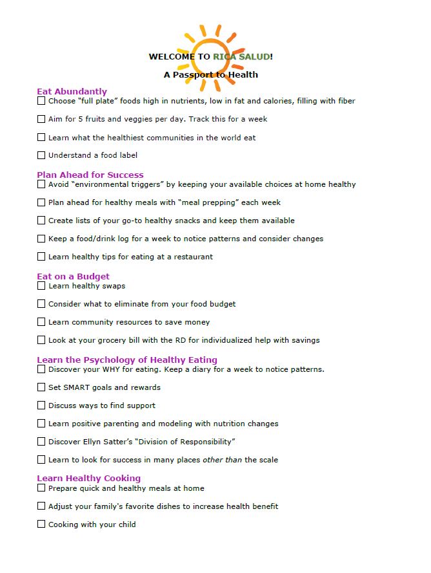
Notes:
I would advocate that every practice should have access to a dietician by telehealth or in person for referral for patients that are > 95% and ready for change. But many practice do not have a dietician to refer to. Most of the nutrition goals can be set by primary care providers if they have the right resources and handouts to guide them. We are sharing all of our resources with you today to make that easier.

Slide 21
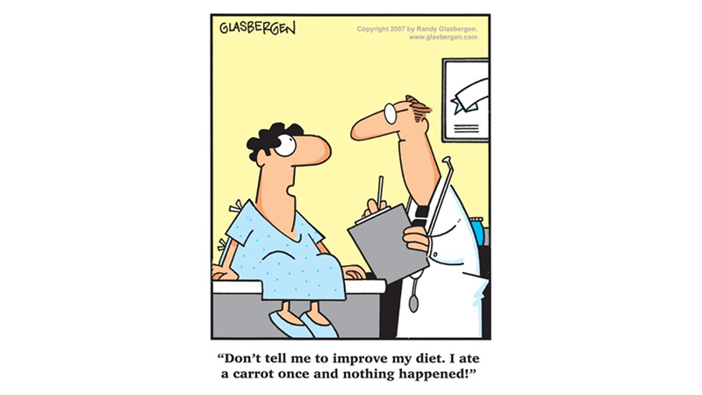
Part 1: Predictable Flow
Part 2: Stage of Change/MI
Part 3: LM Principles
Part 2: Stage of Change and Using MI
Notes:
Behavior Change can be difficult because it’s so personal, non-linear ,and long-term. Also, in pediatrics, it usually involves more than just the identified patient.

Slide 22
“What Motivates People?”

Slide 23
Self-Determination
People are generally better persuaded by the reasons which they have themselves discovered, than by those which have come into the minds of others
Blaise Pascal (1600s)
Notes:
The #1 theory of human behavioral change is SELF DETERMINATION. SD refers to each person's ability to make choices and manage their own life. This is at the foundation of motivational interviewing-- it’s a patient-centered, coaching style that puts the patient in the driver seat as the expert on her own life.

Slide 24
RE-DEFINE OUR ROLE in supporting change
Adopt a “Coach” rather than “Expert” mentality
Acknowledge that the PATIENT/FAMILY is in the driver’s seat.
THEY are the expert in their own life.
RE-DEFINE SUCCESS in terms of behavioral change
Changing health behaviors can lead to significant improvements in long-term
health and well-being even with little to no change in body weight.

Slide 25
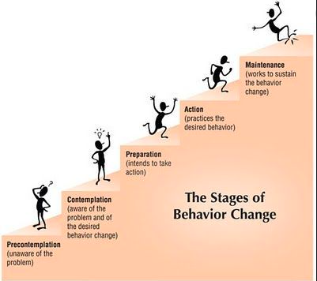
“Meet Patients Where They Are”
Notes:
No matter how high the BMI is or how many comorbidities we recognize...when we give advice and a person isn’t ready, or give advice when we don’t know their situation, or worse when we criticize or shame…. all we do is drive folks away from the very place we hope to point them. The bottom line for us as providers is : We have to pay attention to what our patient is ready to do, not what we are ready to tell them to do . Through our algorithm, we emphasize that readiness to change is at the core of our approach.

Slide 26
“Meet Patients Where They Are”
80% of patients will NOT be ready at first. Our job is helping them move through the early stages.
Motivational Interviewing
Notes:
No matter how high the BMI is or how many comorbidities we recognize...when we give advice and a person isn’t ready, or give advice when we don’t know their situation, or worse when we criticize or shame…. all we do is drive folks away from the very place we hope to point them. The bottom line for us as providers is : We have to pay attention to what our patient is ready to do, not what we are ready to tell them to do . Through our algorithm, we emphasize that readiness to change is at the core of our approach.

Slide 27
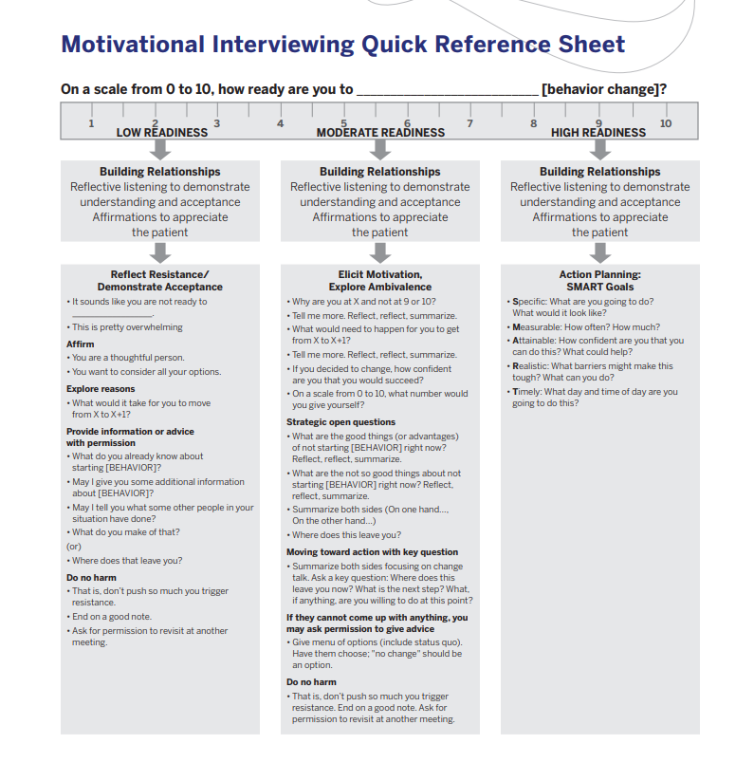
Building relationships Reflective listening Affirmations
Notes:
We have to resist our “righting reflex” when patients aren’t ready for change. Our goal should be to build an alliance with the patient.

Slide 28
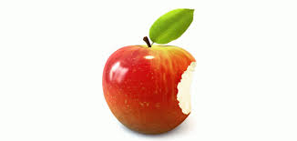
Ready for Change?
Offer Bite-Size In-Office Education
Resist giving too much information
Be direct, neutral, defer to EVIDENCE
“If you are interested in increasing physical activity, the AAP recommends...”

Slide 29
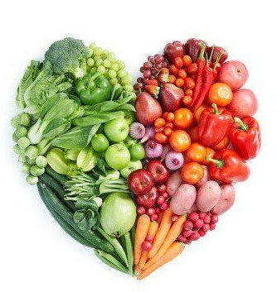
Ready for Change?
“TAF” GOALS
S- specific
M- measurable
A- attainable
R- realistic
T- time-based
Nutrition Example Screen Time Example
Type vegetables screen time
Amount increase to 2 per day (lunch, dinner) decrease to 2 hours per day
Frequency 5 days of the week, school days 5 days per week, school days
Can the goals be attempted with positivity and collaboration?
Notes:
If the patient is truly leading, you should starting with ideas will be both attainable and relevant. Then TAF covers “specific, measurable and time-based”

Slide 30
Ready for Change?
Give “At-Home Learning”
Decide Next Steps
“At-home learning” ** pediatric healthy lifestyle resources ** (our google drive)
Referrals/community resources
Follow-up
*Frequency and quality of interaction linked to success
*Frame Follow up as an “opportunity to “check in and learn”
Notes:
Success is directly related to FREQUENCY and QUALITY of provider contact

Slide 31
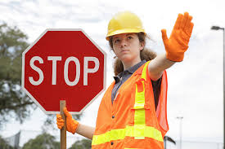
Not Ready for Change?
Think of resistance as a signal to change strategies.
Shift back to THEIR primary goals/concerns
Constipation? Plants provide fiber and water, PA
Mental Health? Sleep, managing stress, PA
ALWAYS leave on a positive note/affirmation
Ask permission to discuss at a future visit
⭐ Labs if indicated and document stage of change⭐

Slide 32
Role play
Also see “Slide 32 Not Ready for Change” on website
https://youtu.be/2sgP1v9yfsE

Slide 33
Obesity and Mental Health
DEPRESSION/ANXIETY
POOR SLEEP
CHRONIC STRESS
Each of these can lead to obesity AND also can result from obesity
Notes:
COMPLEX RELATIONSHIP.
Childhood obesity is linked to mental health issues such as depression and anxiety as an adult. Thought to be related to both physical effects of obesity and the psychosocial co morbidities.
EXAMPLE You may have a patient in your office with DEPRESSION/ANXIETY - they likely have disordered sleep, appetite dysregulation, increased stress hormones, and probably a low level of physical activity and social isolation... all of which can contribute obesity. Or we may have a patient with OBESITY - with comorbidities such as diabetes or SCFE with poor mobility, they may also experience bullying or stigma all of which can lead to depression and anxiety.
SLEEP: Disordered sleep causes disrupts hormones that regulate appetite and insulin, and disordered sleep leads to poor energy which can lead to obesity. OR you can have a patient with OBESITY leading to disordered sleep from co-morbid anxiety/depression or severe OSA
STRESS: A patient with chronic stress or trauma (ACES) is in a state of inflammation often with anxiety, depression, poor sleep, disrupted hormones that regulate appetite, metabolism, and abnormal fat storage leading to obesity OR you may have a patient with obesity who due to the burden of their disease starts experiencing chronic stress

Slide 34
Synergy for the Win!
Habits associated with improved mood:
7+ Fruits/Veggies per day
Regular physical activity
Time in nature
Stress management
Connection with others
Improved sleep quality and quantity
Avoiding Risky Substances
AND those with improved mood are more likely to practice healthy habits
Notes:
And those with improved mood have a higher likelihood of practicing regular healthy habits.

Slide 35
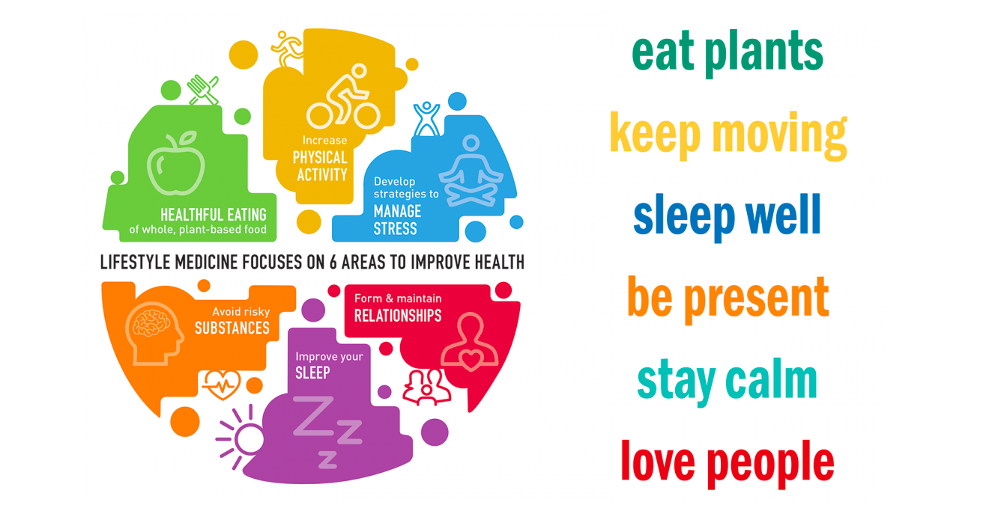
Part 1: Predictable Flow
Part 2: Stage of Change/MI
Part 3: LM Principles
Part 3: Lifestyle Medicine Principles
Notes:
I want to emphasize LM is NOT obesity medicine, but because obesity is a chronic disease, it fits perfectly into the model.
I’ll spend the most time on nutrition but I want to highlight the other pillars and how they can work synergistically or “through the back door” when the patient has a different primary concern

Slide 36
Lifestyle factors account for 80% of disease and 50% of premature death.
The most impactful piece is moving away from the S.A.D (standard american diet) toward whole food, plant-based nutrition

Slide 37
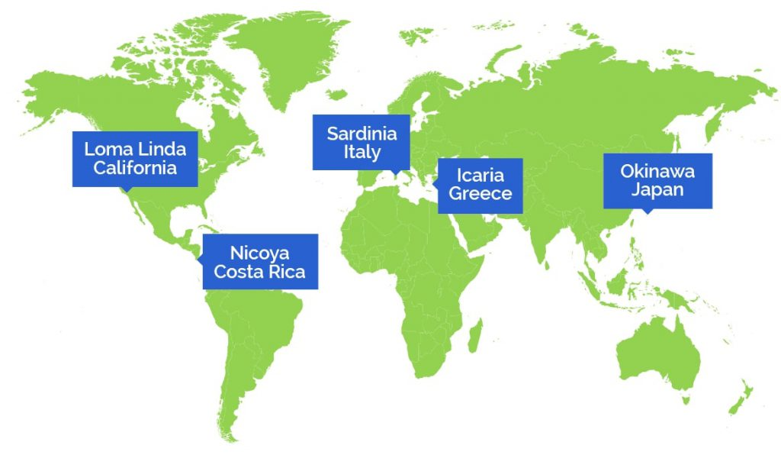
Where DO people live the longest, healthiest lives?
The Blue Zones
Notes:
One thing that is helpful to do is to take a step back and ask “Where do people live the longest, healthiest lives and what do they have in common? These are 5 communities in the world where people live to the age of 100 at a rate that is 10 x greater than in the USA with lower rates of chronic disease I like to point out to my patients that the HEALTHIEST COMMUNITIES IN THE WORLD are NOT the wealthiest in terms of income. These communities are naturally active every day, they are socially connected, and they don’t smoke. Most importantly, they eat the most plants - in fact 95% of their diet is from plants and only 5% comes from animal products. A FAR difference from our eating patterns. These healthy pockets don’t have different DNA than those around them, they have different lifestyle habits.

Slide 38
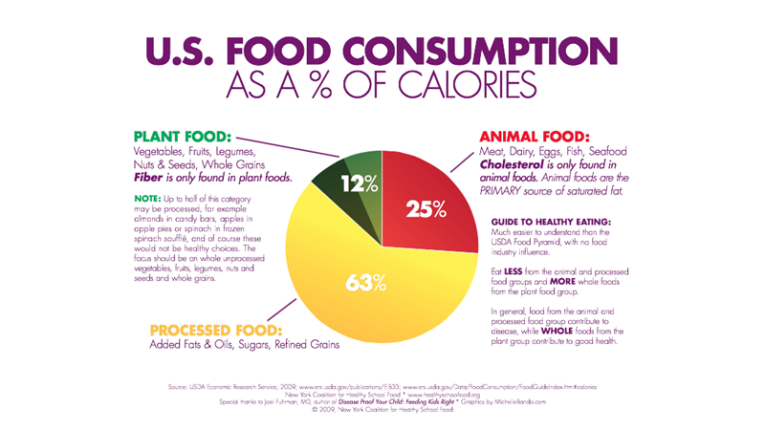
< 3% of Americans get enough fiber
We eat 800 more calories per day than the rest of the world

Slide 39
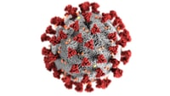
Dietary Quiz
What “staple foods” in the diets of US children are classified by the WHO in the same category as asbestos and tobacco smoke? (Group 1 Carcinogens)
How early are fatty streaks seen in the arteries of US children?
What is the #1 Source of Saturated fat in the US?
A recent study of 592,571 participants in UK and US linked __________ with lower risk of getting COVID-19 and lower risk of having severe disease after infection?
Notes:
Fatty streaks can be seen in children’s arteries as young as 3 yrs old. By 10 nearly ALL children have fatty streaks. By 20, fatty streaks in the CORONARY ARTERIES. A 2018 study published in Nutrition Review found that a Plant Based diet in childhood decreases the risk of CV disease as an adult. This makes sense, because cholesterol ONLY comes from animal products and fiber (that flushes out cholesterol) is ONLY found in plants. In LM, we classify heart disease as a foodborne illness A WFPB diet is the only diet shown to be able to reverse CAD alone without the use of lipid lowering agents
Hot dogs, sausages, ham, beef jerky, corned beef, some deli meats
Healthy plant-based nutrition (Study published in Gut by researchers at Mass General Hospital. Estimated that nearly ⅓ of cases would have been prevented if 1 of 2 exposures were not present - poor diet or socioeconomic deprivation (SDH).

Slide 40
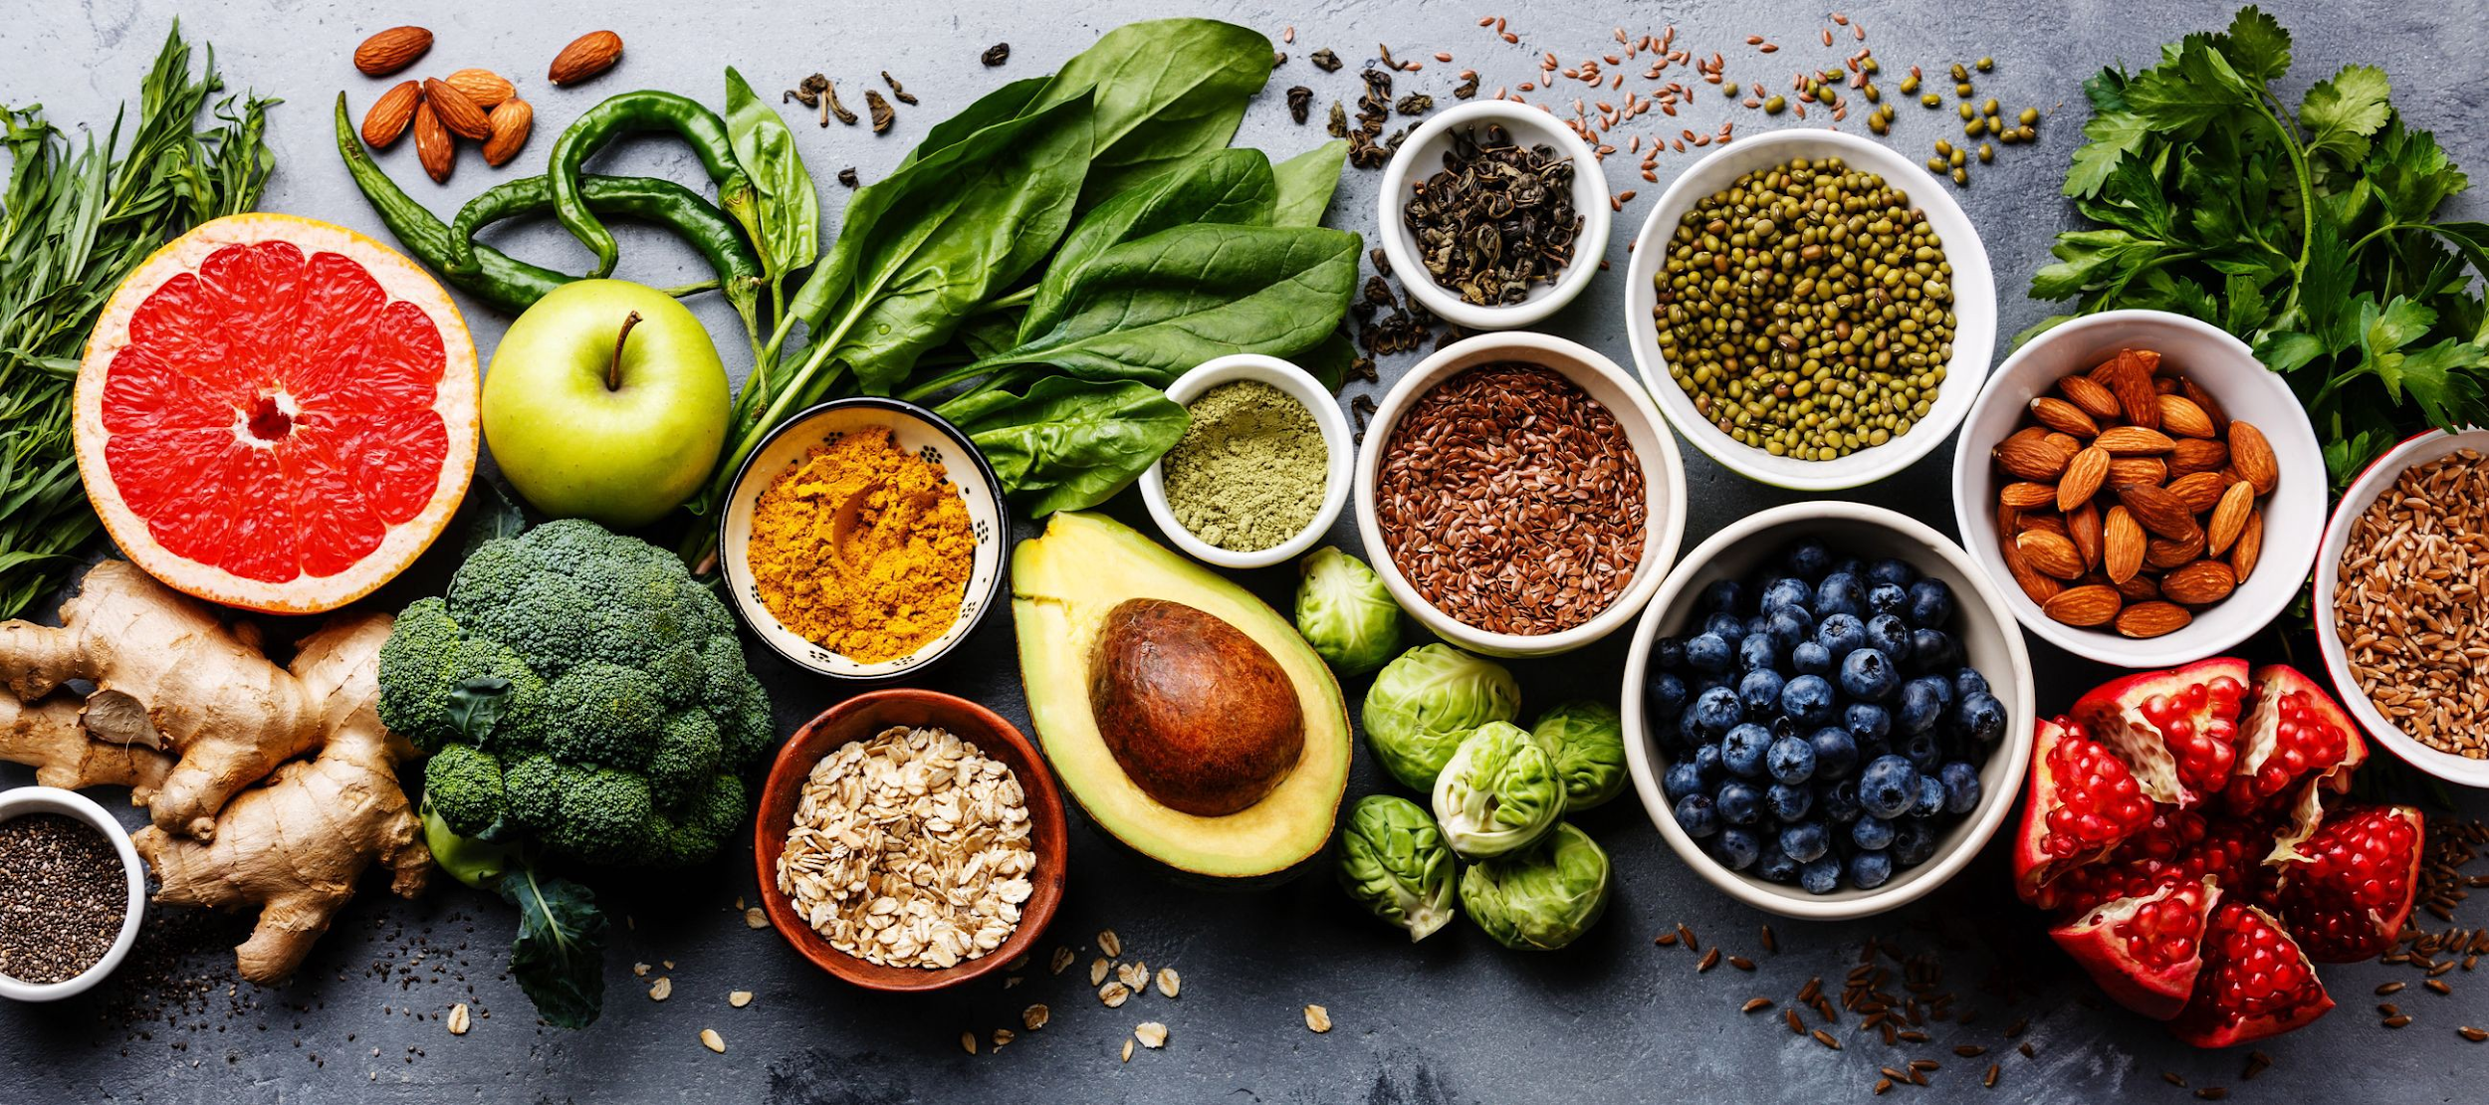
Whole Food Plant Based (WFPB) Nutrition
Maximizes Whole Foods
As found in nature or minimally processed
95% Plant-Based
Veggies, Fruits
Whole Grains
Legumes (beans, pulses)
Nuts, Seeds
Herbs, Spices
Notes:
Although WFPB eating patterns are growing in popularity over recent years, these patterns are strongly rooted in long standing cultural traditions from around the world, which has worked well in our clinic with families who have eating traditions from central and south america, africa and india.

Slide 41
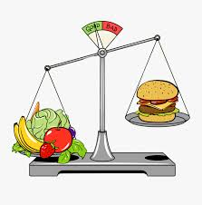
Whole Food Plant Based (WFPB) Nutrition
Minimizes
Highly processed foods and refined carbohydrates
Salt and sugar (small amts for flavor only)
Fats and oils
Animal products
Meat
Dairy
Eggs
If 95%, only 5% calories from animal products = 2 oz < 5x/month
Notes:
Fat intake, cholesterol is only found in animal products. In contrast to plant foods, these foods are calorically dense and low in nutrition value

Slide 42
Core Concepts of WFPB Nutrition
Higher plant intake is anti-inflammatory (nutrient rich)
ONLY plants have fiber
ONLY animal products have cholesterol
Plants have healthier fats (excluding coconut and palm oil)
A plant-based diet ALONE decreases: CAD by 40%
cerebral vascular disease by 29%
metabolic syndrome/T2D by 50%

Slide 43
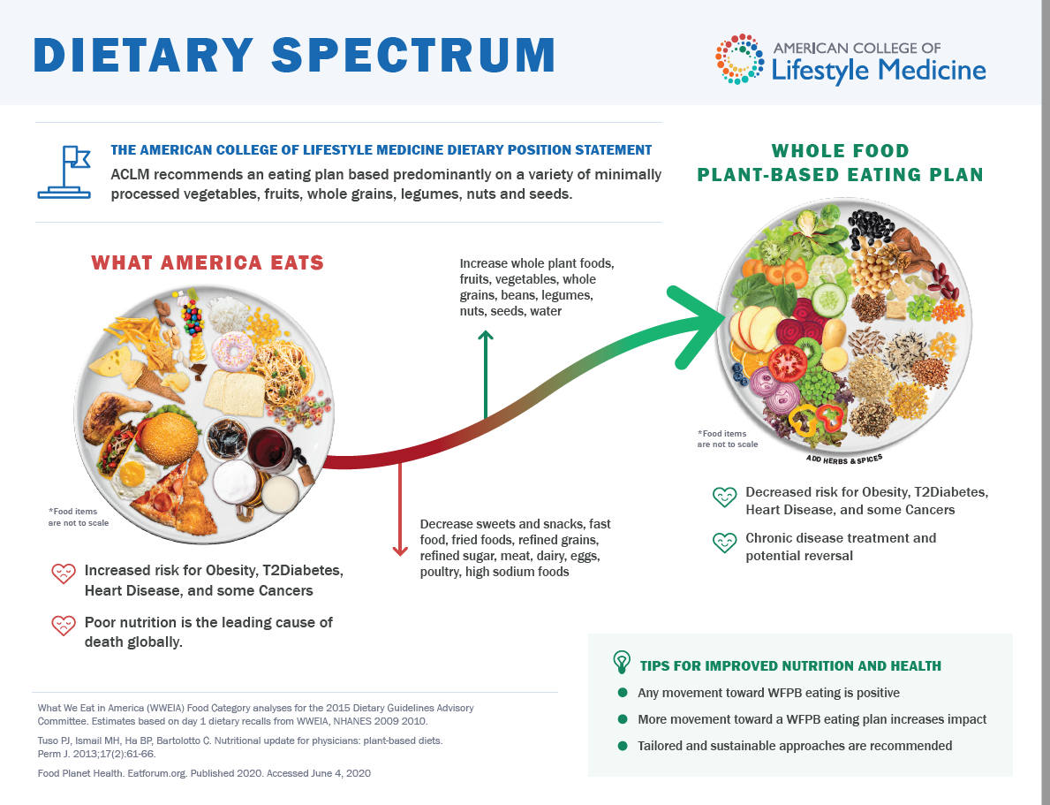
“S.A.D.”
Improving health and longevity in a dose-response manner →
Notes:
A BIG concept I want you to take home is this is about PROGRESS not perfection. Any SHIFT from Left to Right: increasing nutrient-rich foods and increasing health and longevity in a dose-response manner. Meaning “more is better.” The simple key is both an abundance and diversity of plant foods

Slide 44
Wide Endorsement
Academy of Nutrition and Dietetics: Well-planned vegetarian/vegan diets are appropriate for individuals during all stages of the life cycle, including pregnancy, lactation, infancy, childhood, adolescence, and for athletes. 2016
Notes:
This approach aligns with all the major medical societies’ dietary recommendations. . Current research strong supports a WFPB dietary pattern for prevention and treatment of CV disease, overweight, obesity, T2D and well as cancer risk reduction.

Slide 45
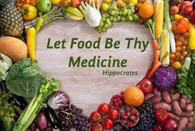
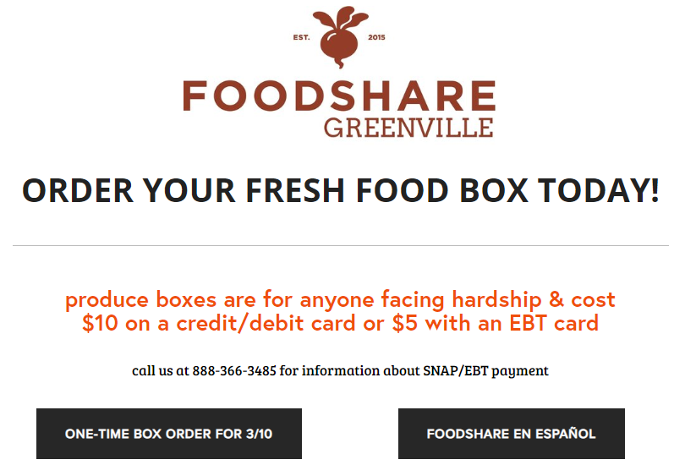
Message of WFPB Nutrition
Nourishment prevention and treatment of disease “Eating for Life”
Abundance “Living Your Best Life” and
not watching calories
Longevity Healthier, Longer
Notes:
Resonates with our patients. Parents don’t like to restrict their children, so we talk about an abundance and variety of nourishing food

Slide 46
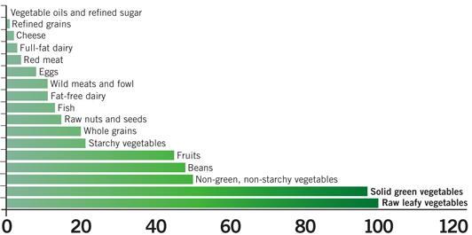
Core Concept: Nutrient Density per Calorie
Animal-based foods
Plant-based foods
Adapted from Eat to Live, Joel Fuhrman.

Slide 47
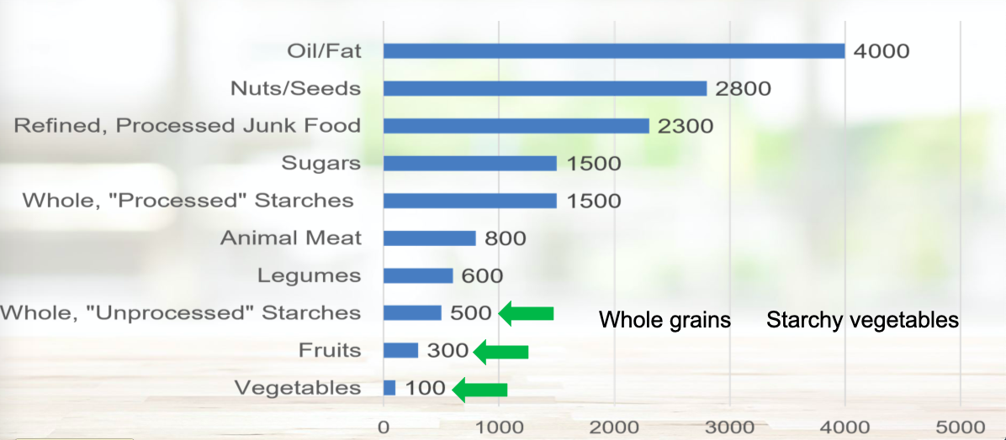
Core Concept: Calorie Density per pound
1 Tbsp = 120 cals!
Credit: ACLM Webinar on Calorie Density

Slide 48
Core Concept: Fiber and Satiety
Notes:
Many weight loss efforts leave people feeling restricted and hungry. FIBER MAKES YOU FEEL FULLER, LONGER (plus it lowers cholesterol, improves many GI issues, and has lower calorie density per pound (which is why it’s helpful with weight loss).

Slide 49
Plant-Based Children vs Omnivores
Higher intake of
Fiber
All vitamins and minerals (except Ca -greens, beans, fortified plant milk)
Fruits and vegetables
Wider variety of whole foods
Recommended intake of
Calories and Protein (meet or exceed RDA for iron)
Lower intake of:
Total fat, saturated fat, cholesterol
Notes:
Compared to kids on SAD, PB children have lower rates of chronic disease as well as lower rates of acne, allergies, URIs, ear infections and digestive diseases. With a PBD there is also less exposure to environmental toxins and pollutants which accumulate as you go up the food chain.

Slide 50
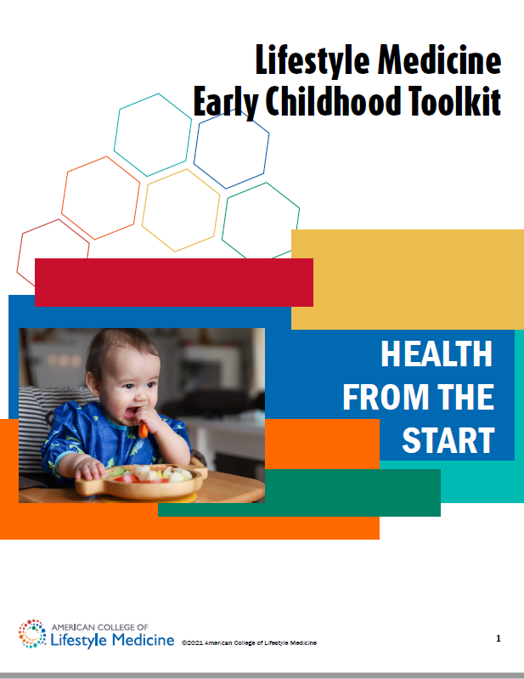
The Youngest Years: Birth-3 years
Different Nutritional Needs Per Kg Compared with Adults
Twice as much Fat
50% more protein
3-4 x more calories
Higher Nutrient Density
This is WELL within what they can get from a PBD
+ 15 oz of breastmilk
AAP -soy formula is safe and appropriate for Full term babies
Notes:
The physicians committee. Veg diets for children right from the start 2002

Slide 51
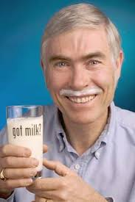
The Dairy Question
AAP RECOMMENDATIONS
0-1 yr NO cows milk
1-2 yr 2-3 cups of whole milk
2-5 yr 2-2.5 cups of skim or 1%
AAP: (Fortified, unsweet) Soy milk is nutritionally equivalent to cow’s milk and is an acceptable alternative.
2020 NEJM “Milk and Health”
!!Equivalent of 24 slices of bacon a week!!
Notes:
Dairy could be an entire lecture onto itself but I just want to plant the idea that our dairy recommendations are more industry driven than health driven. CANADA. Excellent 2020 NEJM article called “Milk and Health” that does a nice job summarizing why we need to seriously rethink our dairy recommendations.
Based on CALORIES for GROWTH and FAT for Brain and Eye development. ¼ of an avacado or ½ Tbsp nut butter would make up the fat difference

Slide 52
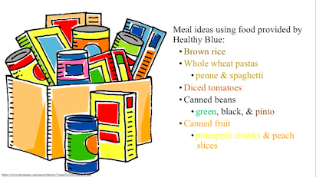
Summary WFPB Tips/Tools
Every time you eat/drink is an opportunity to nourish
Start by eating more of plant foods you DO like
Try something new (frozen edamame below)
Substitute beans for meat (soup or tortilla)
Use less oil in food prep (120 cals per Tbsp!)
Find local sources of inexpensive fresh produce
Notes:
Save money - use a re-usable water bottle and don’t buy drinks. Don’t buy highly processed foods. Use store brand, shelf stable, plant based staples. Supplement with fresh or frozen produce. Support local, affordable plant based initiatives like FOODSHARE
Slide #s in 40s on last slide show from Fall 2021 on WFPB nutrition

Slide 54
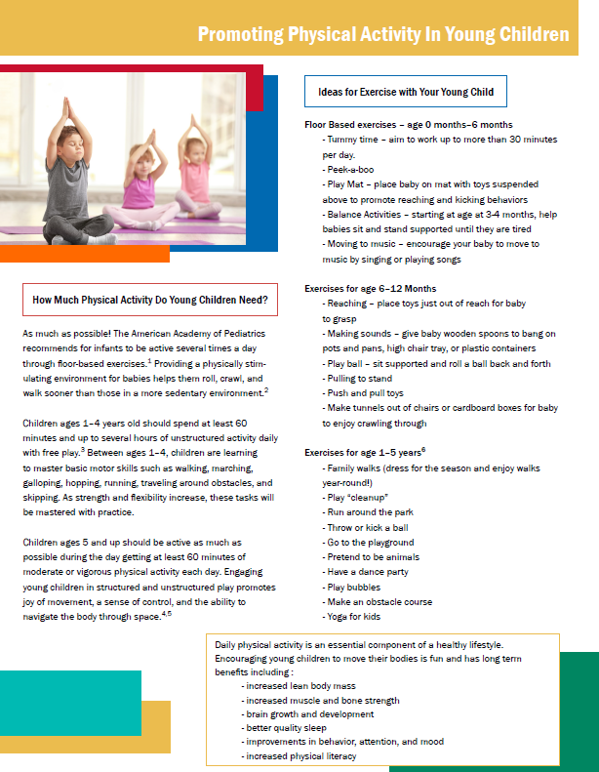
Physical Activity
Physical Activity improves health and longevity regardless of BMI
Think about PA in terms of weight maintenance (not weight loss)
Physical activity is called “The most underutilized antidepressant”
Notes:
“What is enjoyable, accessible, and practical?”
If you remember the blue zones, they just move naturally in their daily life, walking more and sitting less --- all of it is beneficial.
Recommendations by Age:
Toddlers: 3+ hours
Children: 1 hour/day + wt bearing activity
16yr-adults: 150 mins of moderate PA/wk

Slide 55
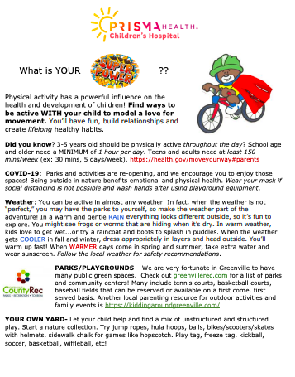
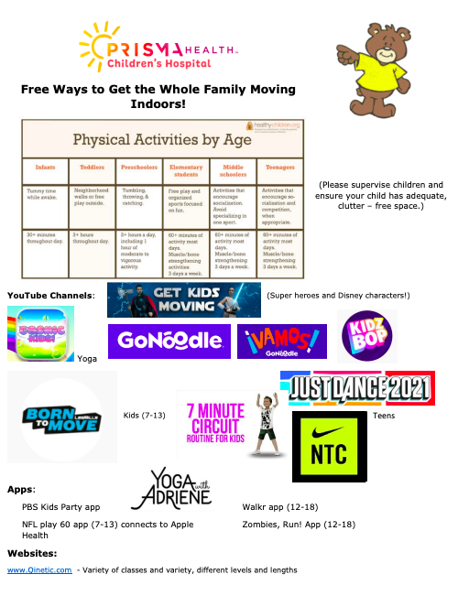
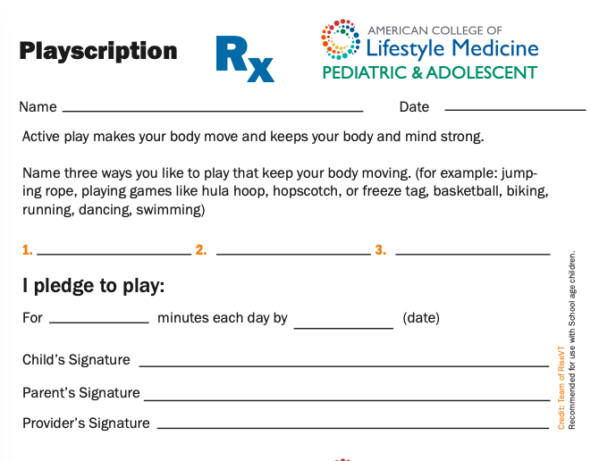

Slide 56
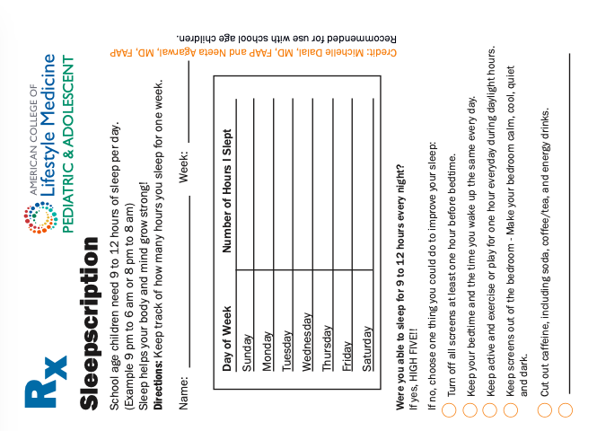
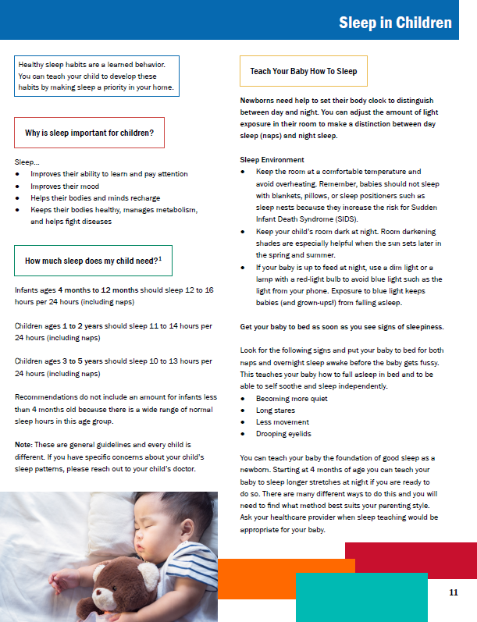
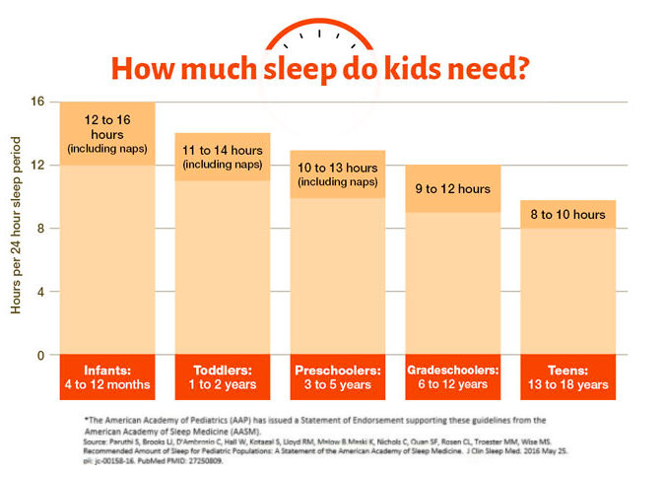
Sleep
Decreased sleep is associated with obesity in childhood, extending into adulthood.
Sleep loss creates hormone imbalance impacting hunger/satiety
The effect of light on endogenous melatonin
Notes:
Sleep loss creates a hormone imbalance in the body that promotes overeating and weight gain. Leptin and ghrelin are hormones that regulate appetite, and when you aren't getting sufficient sleep, the production of these hormones is altered in a way that creates increased feelings of hunger

Slide 57
50-80% of illness has a stress-related component
Notes:
In many studies of lifestyle, social connection is the single most important predictor of happiness, health, and longevity!! Even brief, authentic connection activates the PNS to lower stress

Slide 58
Chronic stress or a maladaptive stress response
–can lead to impaired health and productivity
–can lead to anxiety, depression, obesity, CV disease, IBD, immune dysfunction and assoc poor health and surgical outcomes.
–has a multi-directional impact on the other 5 domains of lifestyle behavior
Mind-body and CBTs have been assoc with improvements in all of these, and mindfulness has one of the largest evidence bases.

Slide 59
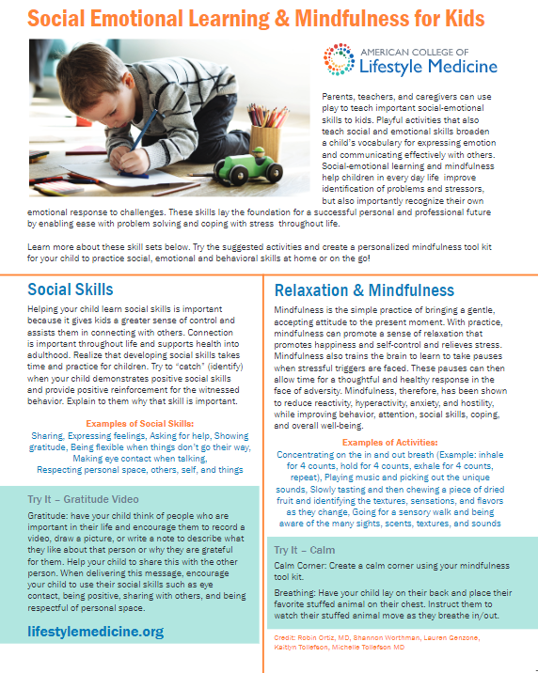
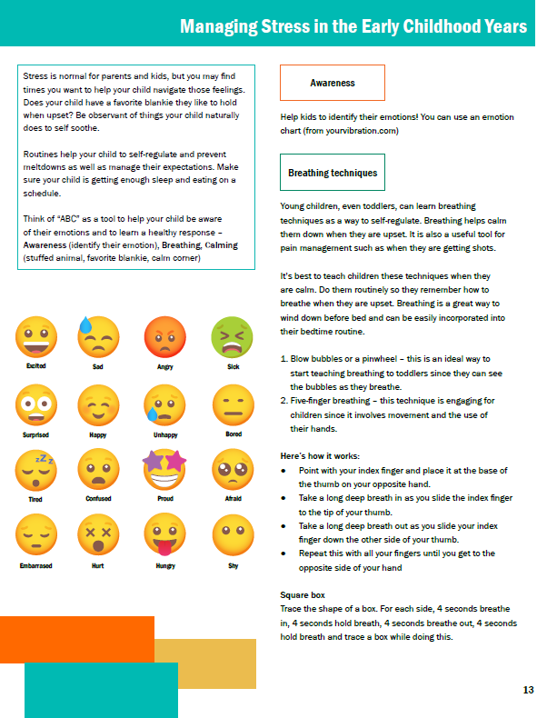
Managing Stress: Younger Children

Slide 60
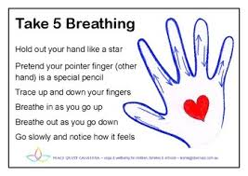
Creating a “Calm Corner” or “Calm Moment”
A = Awareness (time for a break)
B = Breathing (teaching how to calm PNS)
C = Calming (bubbles, “lovie”, music, journal, draw)
Calm Corner: Credit to Michelle Dalal, MD (ACLM)

Slide 61
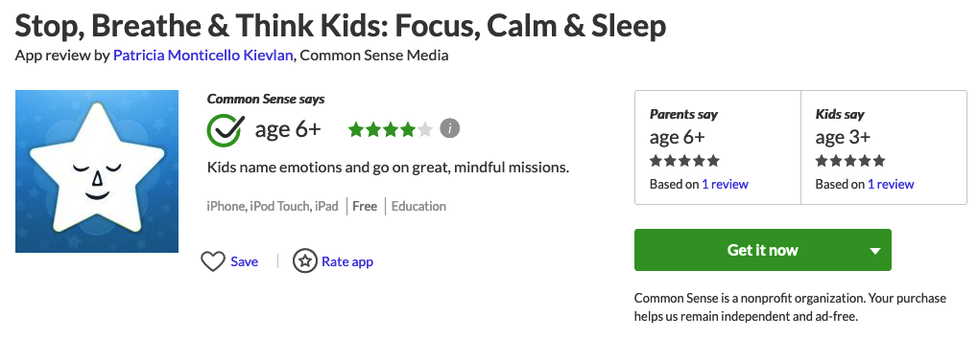
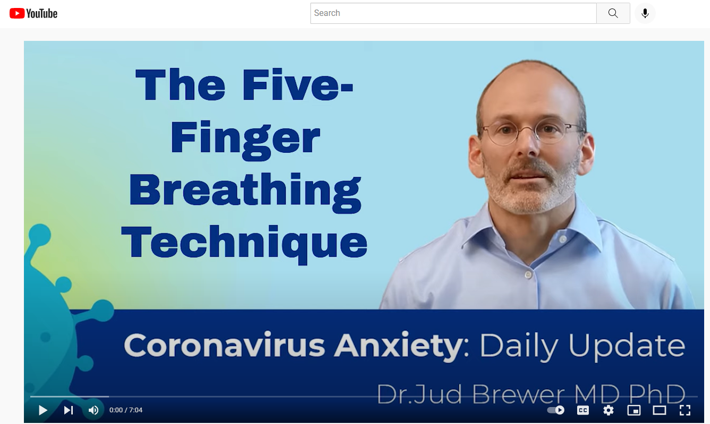
Breathing
Activates your PNS
Lengthen exhale
6 breaths in 1 minute
Mindful apps with a Fee
Calm
Headspace
Fitmind
Smiling Mind
Unwinding Anxiety
Eat Right Now
Notes:
Show to significantly reduce stress in healthcare providers who use it!

Slide 62
Mindfulness Practices
Mindful Walk (or other experience)
Notice how your body moves and feels
Notice your surroundings
What do you: see, hear, smell, feel
*nature
Body Scan
Head to toe slowly relax each part
Five Senses Practice
5 things you can see
4 things you can feel
3 things you can hear
2 things you can smell
1 thing you can taste
Dr. Jud Brewer: 8 FREE provider-training videos in understanding habits, behavior change, mindfulness
Breathe (free)
Eat Right Now
Craving to Quit
Unwinding Anxiety
Free Provider Course
https://drjud.com/health-care-provider-course/

Slide 63
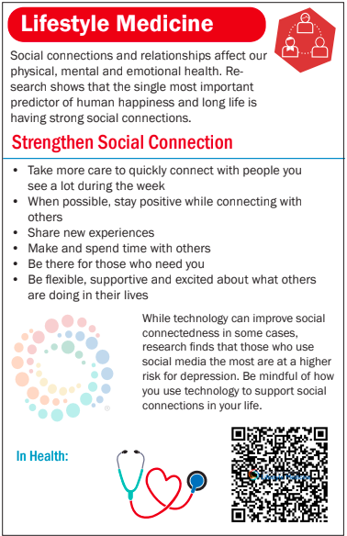
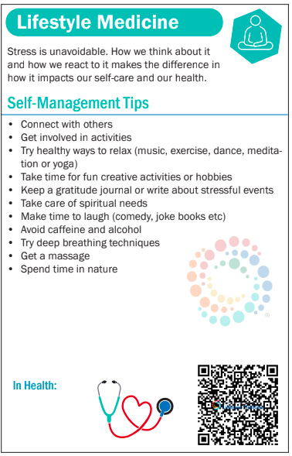
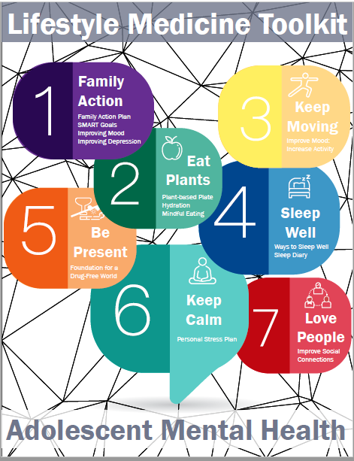
Managing Stress: Teens

Slide 64
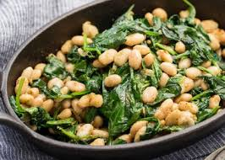
A Lifestyle Medicine Approach to Obesity
OFFICE FLOW is needed and appreciated for consistency
STAGES OF CHANGE/MI Let your visit and your plan reflect that you are meeting patients “where they are”.
LIFESTYLE MEDICINE Care of the patient with obesity is optimized with a comprehensive approach to the individual in their environment starting with any of the 6 pillars. Synergy! LM has great resources to fill our educational gaps as providers.

Slide 65
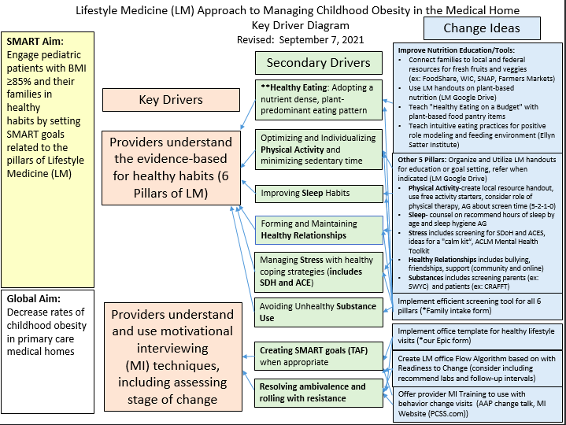
Key driver diagram

Slide 66
“Good Habits Formed At Youth Make All the Difference.”
Aristotle

Slide 67
Motivational Interviewing: One of your best tools!
AAP Change Talk App: An excellent series of 3, 12 minute interactive case studies
Providers Clinical Support System (PCSS): Free 1 hour course 3/19/19
Healthysteps.org: 0-3, Motivational Interviewing, Great list of resources 4/12/2021
Motivational Interviewing for Overweight Children: A Systematic Review
“MI, compared to usual care, revealed positive effects for parent influence on young child anthropometric measures when applied. “ Pediatrics Volume 146, no 5, Nov 2020
Miller and Rollnick
Notes:
Keep Learning!

Slide 68
Lifestyle Medicine Certification
Lifestylemedicine.org
Click on “certification”
Notes:
One of the 1st 2 Med Schools in the Country to incorporate LM across the curriculum for all 4 years. Prisma Health Family Residency program has LM informally incorporated across the curriculum with ABLM certified attendings leading the way. We are currently building and incorporating LM across the curriculum in our Prisma Pediatric Residency Program.
For those who are finished with training, LM Fills gaps for anyone wanting to learn and follow the evidence base in these 6 areas. Physicians surveyed typically report they are not confident in behavioral change counseling or the evidence for lifestyle change particularly nutrition.
— Fastest Growing Medical Subspecialty. It’s a certification that is open to providers who are already board certified for at least 2 years by the american medical board as a generalist or specialist.
—The ACLM started in 2004, The ABLM offered it’s first board certification exam in 2017. It has been a GLOBAL collaboration from the beginning.. We have had several practices interested in certification of at least one of their team since we started this QTIP initiative last year and it’s so exciting!

Slide 69
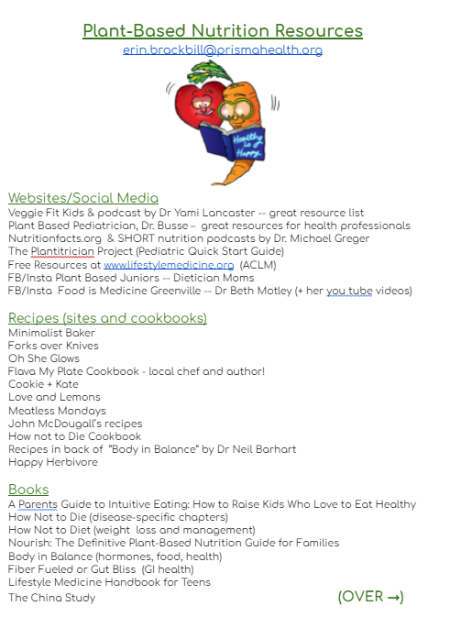

Slide 70
Books

Slide 71
Calorie Density: 1 hour talks

