Slide 1
COMMUNITY SUPPORTS WAIVER
Version 2.0 (7/1/2022)

Slide 2
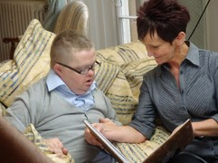
Introduction
Community Supports Waiver (CS)
offers services meant to prevent and/or delay institutionalization of the waiver participants.
reflects the State’s commitment to offering viable community options as an alternative to institutional placement.
Participant service needs are not allowed to exceed the established individual cost limit set forth in the waiver.
This Photo by Unknown Author is licensed under CC BY-NC-ND
Notes:
The Community Supports Waiver, also known as the CS Waiver, offers services meant to prevent and/or delay institutionalization of the waiver participants. This waiver reflects the State’s commitment to offering viable community options as an alternative to institutional placement.
Their service needs are not allowed to exceed the established individual cost limit set forth in the waiver.

Slide 3
Introduction (Cont’d)
The South Carolina Department of Health and Human Services (SCDHHS) has administrative authority for all waivers including the CS Waiver.
Services in this waiver are provided at the local level through county Disabilities and Special Needs (DSN) Boards and qualified private providers mainly through a traditional service delivery system that is
Note: The Waiver programs are not intended to pay for 24- hour care or needs.
PERSON CENTERED and GOAL ORIENTED
Notes:
The South Carolina Department of Health and Human Services (SCDHHS) has administrative authority for all waivers including the CS waiver. The South Carolina Department of Disabilities and Special Needs (SCDDSN) performs waiver operations under a formal Administrative Contract with SCDHHS.
Services in this waiver are provided at the local level through county Disabilities and Special Needs (DSN) Boards and qualified private providers mainly through a traditional service delivery system that is person centered and goal oriented.
Please note that the Waiver programs are not intended to pay for 24-hour care or needs.

Slide 4
Introduction (Cont’d)
The CS Waiver serves people who live in the community and meet the Intermediate Care Facility for Individuals with Intellectual Disabilities (ICF/IID) level of care criteria.
This Photo by Unknown Author is licensed under CC BY-NC-ND
Notes:
The CS Waiver serves people with an intellectual disability and/or related disability who meet the Intermediate Care Facility for Individuals with Intellectual Disabilities (ICF-IID) level of care criteria.

Slide 5
Population Served
Intellectual disability
A condition in which an individual demonstrates significantly below-average intellectual functioning (a valid IQ of 70 or below), and has concurrent deficits in adaptive functioning in at least two of the following areas:
communication
self-care
home living
social/interpersonal skills
use of community resources
self-direction
functional academic skills
work
leisure
health and safety
Notes:
An intellectual disability is defined as:
A condition in which an individual demonstrates significantly below-average intellectual functioning (a valid IQ of 70 or below) and has concurrent deficits in adaptive functioning in at least two of the following areas: communication, self-care, home living, social/interpersonal skills, use of community resources, self-direction, functional academic skills, work, leisure, health and safety.

Slide 6
Population Served (Cont’d)
Related disability
Severe, chronic conditions which are found to be closely related to an intellectual disability or which require treatment similar to that required for individuals with an intellectual disability (e.g., cerebral palsy, epilepsy, etc.)
Onset of a related disability must be diagnosed before the age of 22
This Photo by Unknown Author is licensed under CC BY
Notes:
A related disability is defined as:
Severe, chronic conditions which are found to be closely related to an intellectual disability or which require treatment similar to that required for individuals with an intellectual disability (e.g., cerebral palsy, epilepsy, etc.).
Onset of a related disability must be diagnosed before the age of 22.

Slide 7
Requirements to Participate
In order to become enrolled in the CS Waiver, a potential enrollee must meet the following requirements:
be allocated a waiver slot.
be given the option of receiving services in his/her home and community or in an institution.
be Medicaid enrolled or be eligible to receive South Carolina Medicaid.
have needs that can be met by the provision of waiver services.
meet ICF/IID Level of Care.
Notes:
In order to become enrolled in the CS Waiver, a potential enrollee must meet the following requirements:
be allocated a waiver slot.
be given the option of receiving services in his/her home and community or in an institution. To be enrolled in the waiver, the individual or representative must choose home and community-based services, and this choice must be documented in writing and kept in the participant’s waiver case record. This is called “Freedom of Choice”.
A potential enrollee must:
be Medicaid enrolled or be eligible to receive South Carolina Medicaid.
have needs that can be met by the provision of waiver services.
meet ICF/IID Level of Care.
Once a slot is awarded and all requirements and conditions are met, the applicant may be enrolled in the waiver. Upon enrollment, participants are assessed for needed services. Those services are then developed into a Support Plan and waiver budget. Waiver Case Managers then authorize qualified providers to render services according to the plan.

Slide 8
Overview of Services
The following services may be funded by Medicaid through South Carolina's CS Waiver based on assessed needs. Assessed needs must not exceed the individual cost limit set annually:
Adult Day Health Care (ADHC) Services
Care furnished to someone age 18 or older 5 or more hours per day for one or more days per week, in an outpatient setting, encompassing both health and social services
Adult Day Health Care (ADHC) Nursing
Skilled nursing services provided in the Adult Day Health Care (ADHC) center; limited to ostomy care, urinary catheter care, decubitus/wound care, tracheotomy care, tube feedings and nebulizer treatment
Notes:
The following services may be funded by Medicaid through South Carolina's CS Waiver based on assessed needs. Assessed needs must not exceed the individual cost limit set annually:
Adult Day Health Care (ADHC) Services
Care furnished to someone age 18 or older 5 or more hours per day for one or more days per week, in an outpatient setting, encompassing both health and social services
Adult Day Health Care (ADHC) Nursing
Skilled nursing services provided in the Adult Day Health Care (ADHC) center; limited to ostomy care, urinary catheter care, decubitus/wound care, tracheotomy care, tube feedings and nebulizer treatment

Slide 9
Overview of Services (Cont’d)
In-Home Supports Services
Assistance with activities of daily living and personal care for those participants who are able to self-direct their care either directly or through a responsible party
Career Preparation Services
Time-limited and aimed at preparing individuals for competitive employment. These services can include experiences and exposure to careers and teach such concepts as attendance, task completion, problem solving
Community Services
Services aimed at developing one’s awareness of and participation in the community through exposure to and experiences in the community
"Cheeseburger attack" by woodleywonderworks is licensed under CC BY 2.0.
Notes:
In-Home Supports Services
Assistance with activities of daily living and personal care for those participants who are able to self-direct their care either directly or through a responsible party
Career Preparation Services
Career Preparation Services are time-limited and aimed at preparing individuals for competitive employment. These services can include experiences and exposure to careers and teach such concepts as attendance, task completion, problem solving, interpersonal relations and safety as outlined in the individual’s person-centered plan. Services are designed to create a path to integrated community-based employment for which an individual is compensated at or above minimum wage. On site attendance at the licensed facility is not required to receive services that originate from the facility. The cost for transportation is included in the rate paid to the provider.
Community Services
Services aimed at developing one’s awareness of and participation in the community through exposure to and experiences in the community

Slide 10
Overview of Services (Cont’d)
Day Activity
Activities and services provided to enable participants to achieve, maintain, improve or decelerate the loss of personal care, social or adaptive skills
Employment Services
Intensive, on-going supports for participants for whom competitive employment at or above minimum wage is unlikely absent the provision of supports
Support Center
Non-medical care, supervision and assistance provided in a non-institutional, group setting outside of the participant’s home to people who because of their disability are unable to care for and supervise themselves
Employment
Services
Notes:
Day Activity
Activities and services provided to enable participants to achieve, maintain, improve or decelerate the loss of personal care, social or adaptive skills
Employment Services
Intensive, on-going supports for participants for whom competitive employment at or above minimum wage is unlikely absent the provision of supports
Support Center
Non-medical care, supervision and assistance provided in a non-institutional, group setting outside of the participant’s home to people who because of their disability are unable to care for and supervise themselves.

Slide 11
Overview of Services (Cont’d)
Behavior Support Services
Services to assist people who exhibit problem behaviors to teach new appropriate behaviors and improve their quality of life
Environmental Modifications
Physical adaptations to the participant’s home which are necessary to ensure the safety of the participant (e.g., installation of ramps and grab - bars)
Personal Care 2 Services
Hands on assistance in the performance of Activities of Daily Living (ADLs) for participants aged 21 or older such as assistance with eating, bathing, dressing, toileting, transferring, maintaining continence, and assistance with ambulation
Notes:
Behavior Support Services
Services to assist people who exhibit problem behaviors to teach new appropriate behaviors and improve their quality of life
Environmental Modifications
Physical adaptations to the participant’s home which are necessary to ensure the safety of the participant (e.g., installation of ramps and grab-bars)
Personal Care 2 Services
Hands on assistance in the performance of Activities of Daily Living (ADLs) for participants aged 21 or older such as assistance with eating, bathing, dressing, toileting, transferring, maintaining continence, and assistance with ambulation

Slide 12
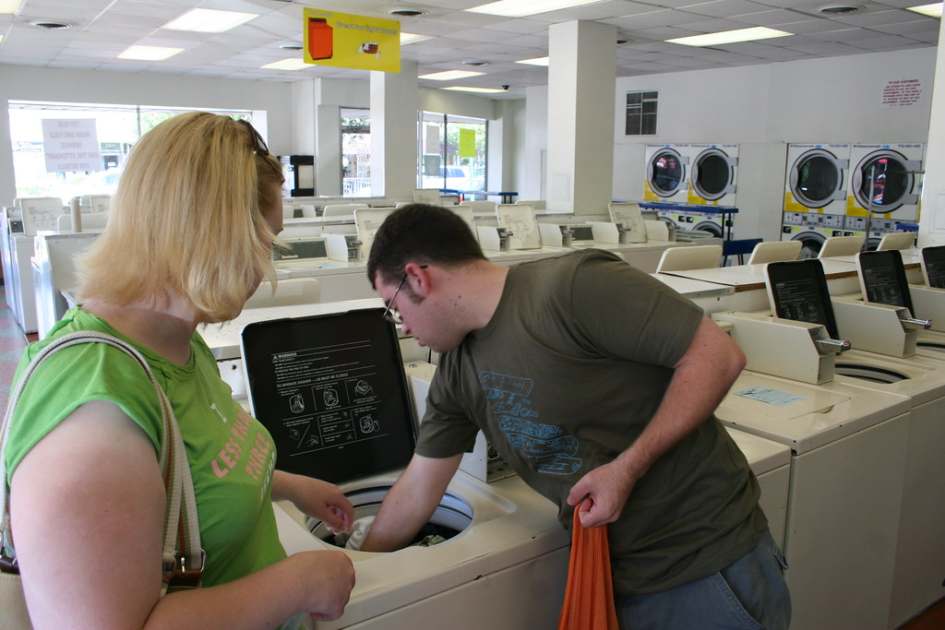
Overview of Services (Cont’d)
Personal Care 1 Services
Assistance with instrumental activities of daily living (IADLs) such as light housework, laundry and meal preparation
Personal Emergency Response System (PERS)
An electronic device that enables participants at high risk of institutionalization to secure help in an emergency
limited to those participants who live alone or who are alone in their own home for three or more hours of the day or night and who would otherwise require extensive routine supervision
Private Vehicle Modifications and Consultation
Private Vehicle Modifications are modifications to a privately owned vehicle used to transport the waiver participant and any equipment needed by the participant which makes the vehicle accessible
Doing the Laundry" by candescent is marked with CC BY-SA 2.0.
Notes:
Personal Care 1 Services
Assistance with instrumental activities of daily living (IADLs) such as light housework, laundry and meal preparation
Personal Emergency Response System (PERS)
An electronic device that enables participants at high risk of institutionalization to secure help in an emergency
limited to those participants who live alone or who are alone in their own home for three or more hours of the day or night and who would otherwise require extensive routine supervision
Private Vehicle Modifications and Consultation
Private Vehicle Modifications are modifications to a privately owned vehicle used to transport the waiver participant and any equipment needed by the participant which makes the vehicle accessible.

Slide 13
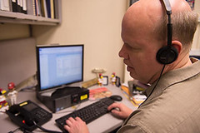
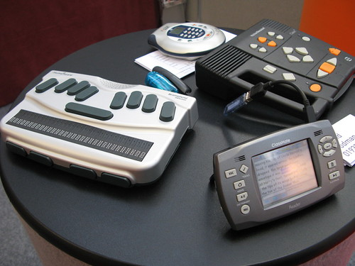
Overview of Services (Cont’d)
Respite Care
Care provided on a short - term basis because of the absence or need for relief of those persons normally providing the care
Assistive Technology and Appliances and Consultation
A device, an item, piece of equipment, or product system, that is used to increase or improve functional capacities of participants thereby resulting in a decrease or avoidance of need for other waiver services (e.g., personal care, respite, etc.)
Incontinence Supplies
Diapers, underpads, wipes, liners, and disposable gloves provided to participants who are at least twenty-one (21) years old and who are incontinent of bowel and/or bladder according to the established medical criteria
"Assistive Technology" by AUCD is licensed under CC BY-NC 2.0.
"Assistive technology gadgets" by Rain Rabbit is licensed under CC BY-NC 2.0.
Notes:
Respite Care
Care provided on a short-term basis because of the absence or need for relief of those persons normally providing the care
Assistive Technology and Appliances and Consultation
A device, an item, piece of equipment, or product system, that is used to increase or improve functional capacities of participants thereby resulting in a decrease or avoidance of need for other waiver services (e.g., personal care, respite, etc.)
Incontinence Supplies
Diapers, underpads, wipes, liners, and disposable gloves provided to participants who are at least twenty-one (21) years old and who are incontinent of bowel and/or bladder according to the established medical criteria

Slide 14
Overview of Services (Cont’d)
Waiver Case Management
Services that assist participants in gaining access to needed waiver and other State plan services, as well as medical, social, education and other services, regardless of the funding sources for the services to which access is gained
Transitional Waiver Case Management
WCM shall only be provided to participants who are residing in a community setting. However, as an exception, WCM may be provided to a participant transitioning to a community setting following an institutional stay (e.g., nursing home, in-patient psychiatric hospital, ICF/IID or PRTF). WCM may be provided for up to 180 days prior to the participant’s waiver enrollment date.
Medical
Social
Education
Notes:
Waiver Case Management
Services that assist participants in gaining access to needed waiver and other State plan services, as well as medical, social, education and other services, regardless of the funding sources for the services to which access is gained
Transitional Waiver Case Management
WCM shall only be provided to participants who are residing in a community setting. However, as an exception, WCM may be provided to a participant transitioning to a community setting following an institutional stay (e.g., nursing home, in-patient psychiatric hospital, ICF/IID or PRTF). WCM may be provided for up to 180 days prior to the participant’s waiver enrollment date.
Further information and details on these services and specific limitations related to these services are discussed in Chapter 9 of the CS Waiver Manual that you can find on SCDDSN’s website.

Slide 15
CS Waiver Cost Cap
The purpose of this waiver is to offer services that will prevent and/or delay institutionalization to people with intellectual disability and/or related disabilities whose waiver service needs will not exceed a predetermined amount per year.
The yearly amount may be adjusted in future years.
Notes:
The purpose of this waiver is to offer services that will prevent and/or delay institutionalization to people with intellectual disability and/or related disabilities whose waiver service needs will not exceed a predetermined amount per year. The yearly amount may be adjusted in future years.

Slide 16
Waiting List Management
All applicants will be enrolled in the CS Waiver based on earliest referral date.
A slot has been reserved for the following applicants. They will be given priority and may be enrolled in the CS Waiver without being placed on a waiting list:
Those individuals currently receiving DDSN- funded Day Services
Those individuals who are transferring from the Intellectual Disability/Related Disabilities Waiver.
Waiting List
Notes:
All applicants will be enrolled in the CS Waiver based on earliest referral date.
A slot has been reserved for the following applicants. They will be given priority and may be enrolled in the CS Waiver without being placed on a waiting list:
Those individuals currently receiving DDSN-funded Day Services
Those individuals who are transferring from the Intellectual Disability/Related Disabilities Waiver.

Slide 17
Services, Policies and Procedures
This Photo by Unknown Author is licensed under CC BY-SA
All waiver services, policies and procedures are housed on the SCDDSN website (www.scddsn.gov) and can be accessed when needed.
Notes:
No need to feel overwhelmed. All waiver services, policies and procedures are housed on the SCDDSN website and can be accessed when needed.

