Slide 1

HEAD AND SPINAL CORD INJURY WAIVER
Version 2.0 (7/1/2022)

Slide 2
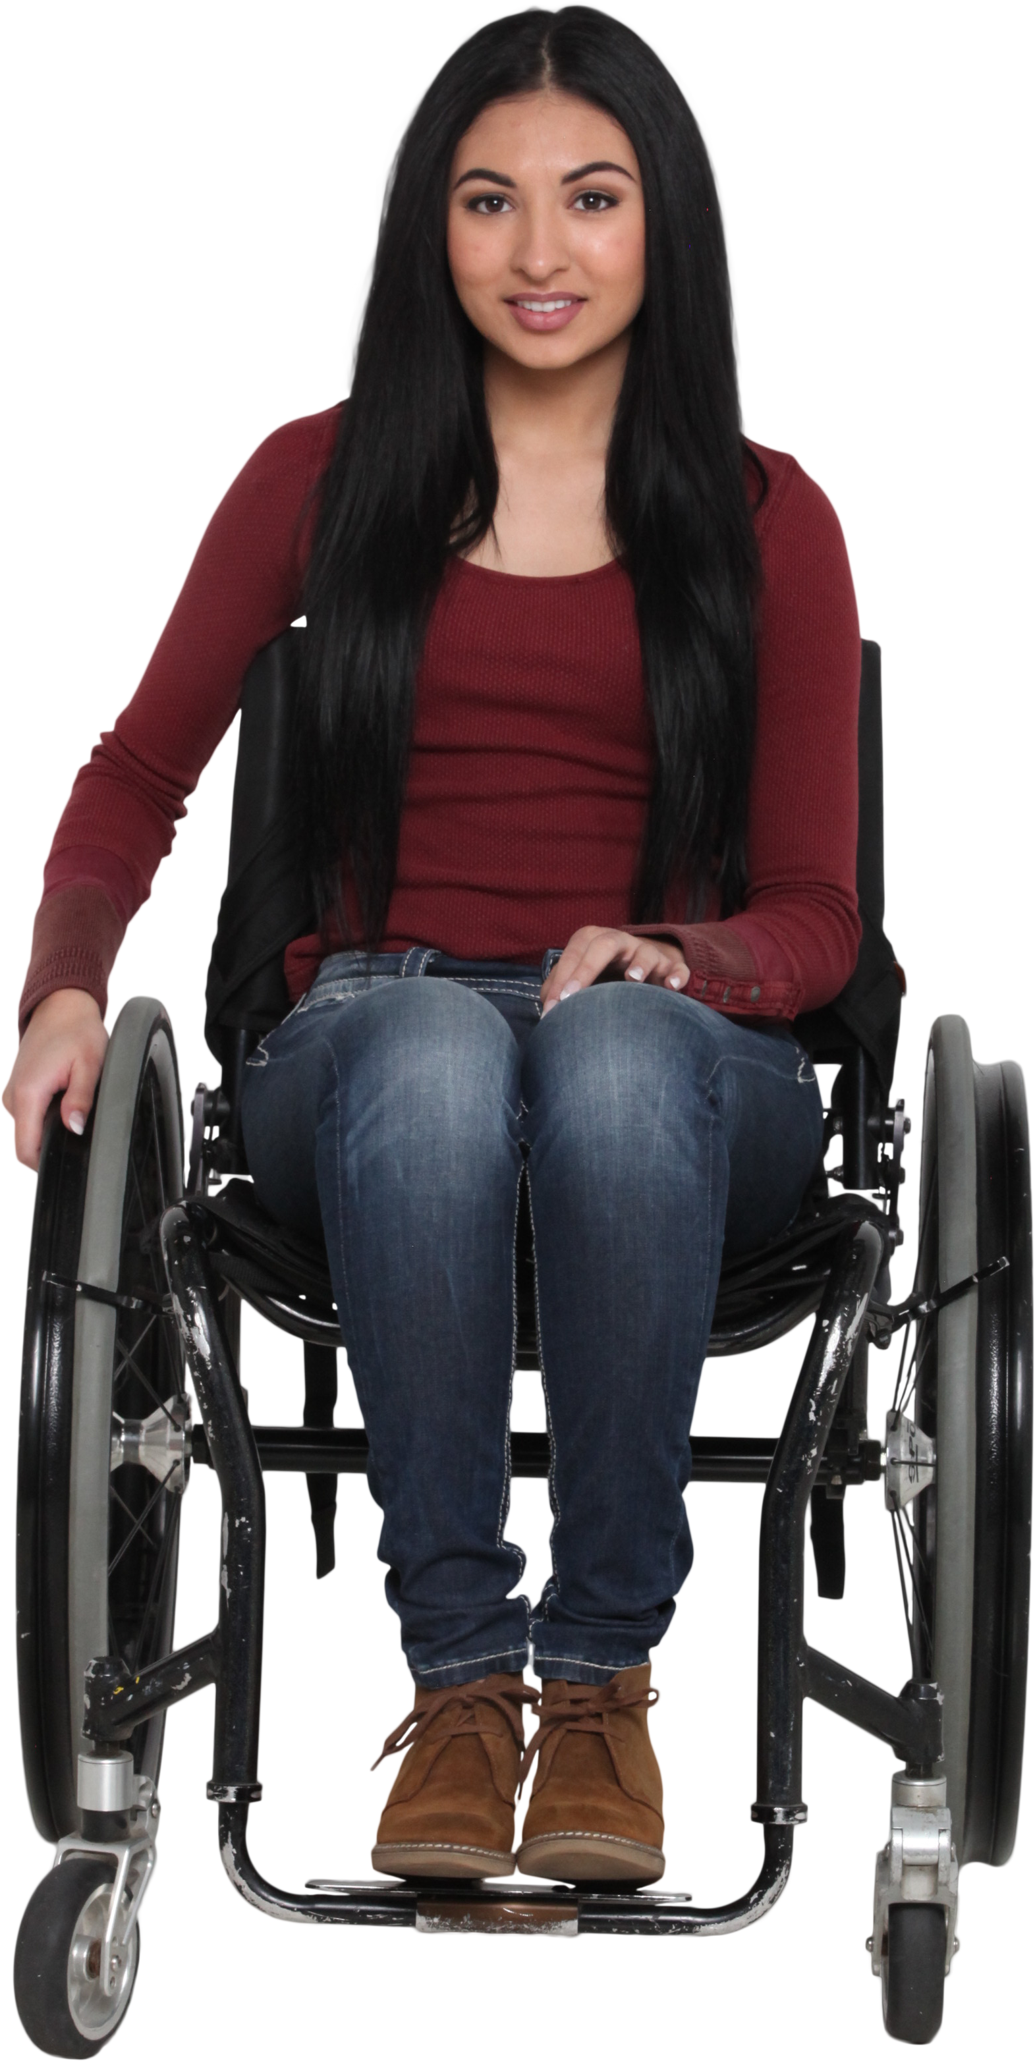
Introduction
Head and Spinal Cord Injury (HASCI) Waiver
-Traumatic brain injury
-Spinal cord injury
-Similar disability
Services offered in the HASCI Waiver are
meant to prevent and/or delay
institutionalization of the participants
Notes:
The Head and Spinal Cord Injury (HASCI) Waiver serves people with a diagnosis of traumatic brain Injury, spinal cord injury, or similar disability. To be eligible for the waiver, an applicant must meet either Nursing Facility (NF) or Intermediate Care Facility for Individuals with Intellectual Disabilities (ICF/IID) Level of Care criteria.
Services offered in the HASCI Waiver are meant to prevent and/or delay institutionalization of the participants. This reflects the State’s commitment to offer practical community options to institutional placement.

Slide 3

Administrative Authority
South Carolina Department of Health and Human Services (SCDHHS) has administrative authority for all the state Home and Community Based Services (HCBS) Waiver programs, including the HASCI Waiver.
South Carolina Department of Disabilities and Special Needs (SCDDSN) performs waiver operations under a formal Administrative Contract with SCDHHS.
This Photo by Unknown Author is licensed under CC BY
Notes:
The South Carolina Department of Health and Human Services (SCDHHS) has administrative authority for all of the state Home and Community Based Services (HCBS) Waiver programs, including the HASCI Waiver. South Carolina Department of Disabilities and Special Needs (SCDDSN) performs waiver operations under a formal Administrative Contract with SCDHHS.
Services funded by the HASCI Waiver are primarily received from professionals, agencies, and companies directly enrolled with SCDHHS as a Medicaid provider. Some services are received through county Disabilities and Special Needs (DSN) Boards or other qualified providers contracted with SCDDSN.

Slide 4
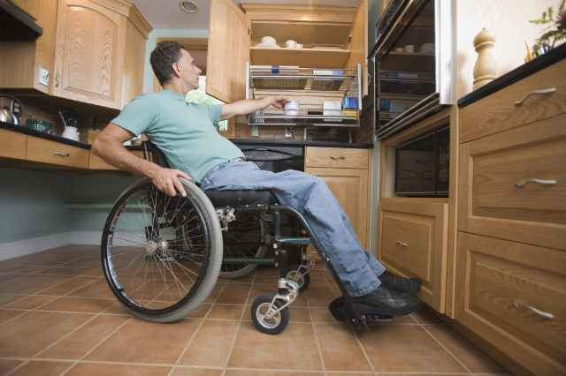

Population Served
Traumatic Brain Injury
    Spinal Cord Injury
        Similar Disability
Notes:
The HASCI Waiver is unique as it assists people who are just like you, but through a traumatic life event have found themselves in need of extra supports to do the things they used to be able to do independently.
The HASCI Waiver serves people who meet the diagnostic criteria of Traumatic Brain Injury, Spinal Cord Injury, or Similar Disability as designated in South Carolina Code of Laws, Section 44-38-370.

Slide 5
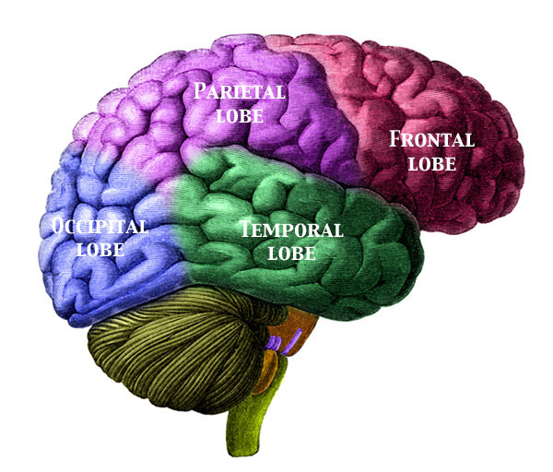
Traumatic Brain Injury (TBI)
An injury to the skull or brain, not of a degenerative or congenital nature, but caused by an external force.
The injury may produce a diminished or altered state of consciousness resulting in impairment in cognitive abilities or physical functioning, as well as behavioral and/or emotional functioning.
This Photo by Unknown Author is licensed under CC BY-SA
It does not include stroke or aneurysm.
Notes:
Traumatic Brain Injury (TBI) is an injury to the skull or brain, not of a degenerative or congenital nature, but caused by an external force. The injury may produce a diminished or altered state of consciousness resulting in impairment in cognitive abilities or physical functioning, as well as behavioral and/or emotional functioning. It does not include stroke or aneurysm.

Slide 6


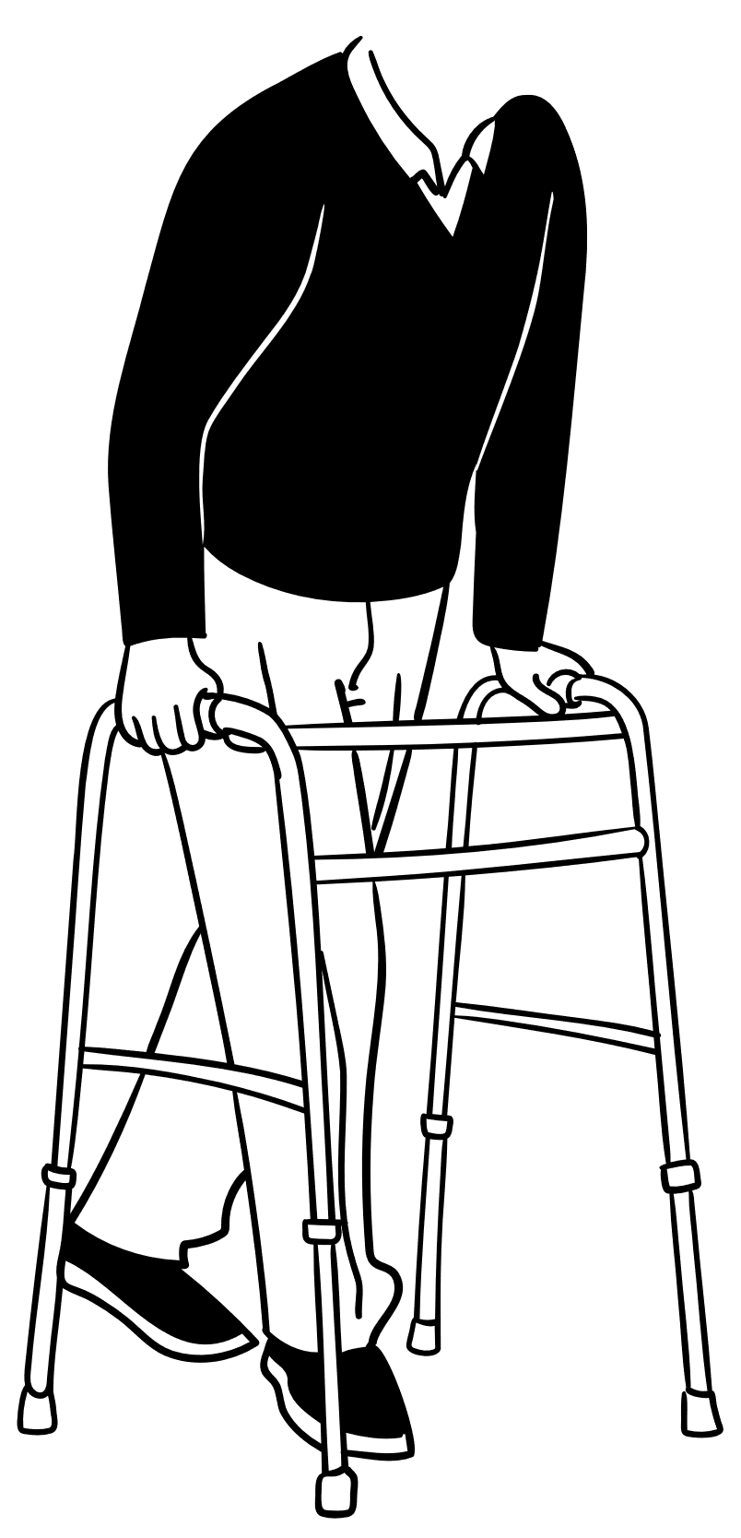
Spinal Cord Injury (SCI)
An acute traumatic lesion of neural elements in the spinal canal, resulting in any degree of deficit in sensory, motor, and life functions.
The deficit may be temporary or permanent.
Notes:
Spinal Cord Injury (SCI) is an acute traumatic lesion of neural elements in the spinal canal, resulting in any degree of deficit in sensory, motor, and life functions. The deficit may be temporary or permanent.

Slide 7

Similar Disability (SD)
A condition similar to TBI or SCI, but not associated with the process of a progressive degenerative illness or dementia, or a neurological disorder related to aging.
Notes:
Similar Disability (SD) is a condition similar to TBI or SCI, but not associated with the process of a progressive degenerative illness or dementia, or a neurological disorder related to aging.

Slide 8
Functional Limitations
Self-care
Communication
Learning
Mobility
Self-direction
Independent Living
Economic Self-Sufficiency
Notes:
In addition to a diagnosis of TBI, SCI, or SD, the person must have substantial functional limitations in at least two areas of life activity:
self-care
receptive and expressive communication
learning
mobility
self-direction
capacity for independent living
economic self-sufficiency

Slide 9
Requirements to Participate
In order to become enrolled in the HASCI Waiver, a participant must meet specific requirements and other conditions. A potential participant must:
be allocated a HASCI Waiver participant slot.
be given “Freedom of Choice” to receive services in his/her home and community instead of in an institutional placement.
be Medicaid enrolled or be eligible to receive South Carolina Medicaid.
Notes:
In order to become enrolled in the HASCI Waiver, a participant must meet specific requirements and other conditions. A potential participant must:
Be allocated a HASCI Waiver participant slot.
HASCI Waiver slots are currently allocated by the SCDDSN Head and Spinal Cord Injury Division. See Chapter 3 of the HASCI Waiver Manual (Eligibility and Slot Allocation).
Be given “Freedom of Choice” to receive services in his/her home and community instead of in an institutional placement.
The individual or representative must choose home and community-based services, and this choice must be documented in writing and maintained permanently in the participant’s Waiver case record. See Chapter 4 of the HASCI Waiver Manual (Enrollment and Termination)
Be Medicaid eligible or be eligible to receive South Carolina Medicaid.
This does not mean that the potential participant must be receiving Medicaid but instead means that, once application is made, Medicaid will likely be awarded. The determination of eligibility for Medicaid is made by the SC Department of Health and Human Services Eligibility Division (SCDHHS). A waiver participant must maintain Medicaid eligibility in order to remain enrolled in the waiver.

Slide 10

Level of Care
A potential HASCI Waiver participant must:
meet Level of Care (LOC) criteria for a Nursing Facility (NF) or an Intermediate Care Facility for Individuals with Intellectual Disability (ICF/IID).
Notes:
A potential HASCI Waiver participant must:
Meet Level of Care (LOC) criteria for a Nursing Facility (NF) or an Intermediate Care Facility for Individuals with Intellectual Disability (ICF/IID).
The initial Level of Care (LOC) Determination must be determined within 30 days prior to enrollment in the HASCI Waiver. A participant’s LOC Determination must be re-evaluated within every 365 days. See Chapter 4 of the HASCI Waiver Manual titled Enrollment and Termination.
The majority of participants in the HASCI Waiver must qualify under NF Level of Care as determined by a nurse employed/contracted with SCDHHS. However, persons whose injury or disability happened before the age of 22 may also meet ICF/IID LOC criteria. Discuss the LOC criteria options with your Supervisor to determine which route is most appropriate.

Slide 11
Potential HASCI Waiver Participant
Depend on Others
Need services not available from existing sources
Have sufficient independence/ natural supports
Be enrolled prior to age 65
Notes:
A potential HASCI Waiver participant must:
Depend on others to provide, assist with, or supervise/monitor critical health needs and/or personal care and basic activities of daily living;
Need services or assistance not available from existing resources, including family, private funds, and other agencies/programs;
(Please note: The HASCI Waiver is the last payer after utilizing all other funding and resources available to the person.)
Have sufficient independence/natural supports to live safely in a private residence or other community setting with limited HASCI Waiver services and other available services/resources; and
Be enrolled in the HASCI Waiver prior to age 65 years. Current participants remain eligible after their 65th birthday if all other eligibility factors continue to be met.

Slide 12

Enrollment
After all requirements are met, the potential participant can be enrolled in the HASCI Waiver.
Upon enrollment, qualified providers chosen by the participant may be authorized by the waiver case manager to render needed services that are specified on the participant’s Support Plan and included in his or her approved HASCI Waiver budget.
This Photo by Unknown Author is licensed under CC BY-NC-ND
Notes:
After all requirements are met, the potential participant can be enrolled in the HASCI Waiver.
Upon enrollment, qualified providers chosen by the participant may be authorized by the Waiver Case Manager to render needed services that are specified on the participant’s Support Plan and included in his or her approved HASCI Waiver budget.

Slide 13
Overview of Services
Attendant Care/Personal Assistance (AC/PA)
Direct assistance with personal care and activities of daily living and/or supervision/cueing to assure health and safety. Self-Directed Attendant Care (UAP Option) allows a HASCI Waiver participant to recruit, employ, train, supervise, and fire his or her own attendant(s). If the participant is not capable of self-direction, a Responsible Party can be designated to perform these functions on behalf of the participant.
  limited to 49 hours per week (see HASCI Waiver Manual for time-limited exception)
  if both AC/PA and Medicaid Waiver Nursing are received by a participant, the total hours for the combination of the two services cannot exceed 10 hours per day or 70 hours per week
  there is an option for Self-Directed Attendant Care
Behavior Support
Services to assist people who experience challenging behaviors to teach new behaviors and better ways to communicate to improve their quality of life
Notes:
Each approved HCBS Waiver document specifies the services that are available through that program and includes applicable limitations on those services. Please note, the Waiver programs are not intended to pay for 24-hour care or needs. Waiver services assist participants to live in the community utilizing all other identified resources including their own.
The following is a summary of services that may be funded by the HASCI Waiver, based on assessed needs of the participant.
Attendant Care/Personal Assistance (AC/PA)
Direct assistance with personal care and activities of daily living and/or supervision/cueing to assure health and safety. Self-Directed Attendant Care (UAP Option) allows a HASCI Waiver participant to recruit, employ, train, supervise, and fire his or her own attendant(s). If the participant is not capable of self-direction, a Responsible Party can be designated to perform these functions on behalf of the participant.
limited to 49 hours per week (see HASCI Waiver Manual for time-limited exception;
if both AC/PA and Medicaid Waiver Nursing are received by a participant, the total hours for the combination of the two services cannot exceed 10 hours per day or 70 hours per week; and
there is an option for Self-Directed Attendant Care
Behavior Support
Services to assist people who experience challenging behaviors to teach new behaviors and better ways to communicate to improve their quality of life

Slide 14
Overview of Services (Cont’d)
Career Preparation
Services aimed at preparing individuals for competitive employment. These services can include such concepts as attendance, task completion, problem solving and interpersonal relations and safety
Day Activity
Activities and services provided to assist with acquisition, retention, or improvement of self-help, socialization, and adaptive skills in a licensed day program
Day Activity is designed to assist in community integration
Employment Services
Intensive, on-going supports for participants for whom competitive employment at or above minimum wage is unlikely absent the provision of supports
Notes:
Career Preparation
Career preparation services are time-limited and aimed at preparing individuals for competitive employment. These services can include experiences and exposure to careers and teach such concepts as attendance, task completion, problem solving, interpersonal relations and safety as outlined in the individual’s person-centered plan. Services are designed to create a path to integrated community-based employment for which an individual is compensated at or above minimum wage. On site attendance at the licensed facility is not required to receive services that originate from the facility. The cost for transportation is included in the rate paid to the provider.
Day Activity
Activities and services provided to assist with acquisition, retention, or improvement of self-help, socialization, and adaptive skills in a licensed day program. Day Activity is also designed to assist in community integration.
Employment Services
Intensive, on-going supports for participants for whom competitive employment at or above minimum wage is unlikely absent the provision of supports

Slide 15

Overview of Services (Cont’d)
Environmental Modifications
Physical adaptations to the participant’s private home which are necessary to ensure health and safety or enable more independence of the participant
  subject to HASCI Division Guidance for Environmental and Private Vehicle Modifications
  limited to $20,000 per modification
Health Education for Consumer-Directed Care
Instruction by a registered nurse to assist a participant to monitor their own health and manage personal care provided by another person; a family member or other representative may be designated if a person is not capable of self-management
Notes:
Environmental Modifications
Physical adaptations to the participant’s private home which are necessary to ensure health and safety or enable more independence of the participant
subject to HASCI Division Guidance for Environmental and Private Vehicle Modifications
limited to $20,000 per modification
Health Education for Consumer-Directed Care
Instruction by a registered nurse to assist a participant to monitor their own health and manage personal care provided by another person; a family member or other representative may be designated if a person is not capable of self-management

Slide 16
Overview of Services (Cont’d)
Incontinence Supplies (IS)
Diapers, briefs (protective underwear), incontinence pads (liners), underpads, wipes, and gloves needed by an adult age 21 years or older who is incontinent of bladder and/or bowel; it is an Extended State Plan service for additional items above limits of Medicaid State Plan
Physician Certification of Incontinence must be completed initially and annually thereafter and kept on file by the IS provider
Participant must be assessed using the SCDDSN Incontinence Supply Assessment form to determine amount and frequency of items to be authorized
After limits of IS for adults through Medicaid State Plan are first accessed,
the following IS can be funded through HASCI Waiver:
    Diapers up to 192 diapers a month
    Briefs up to 160 briefs a month
    Incontinence Pads up to 260 pads a month
    Under Pads up to 2 cases a month
    Wipes up to 8 boxes a month
    Gloves up to 4 boxes a month
Notes:
Incontinence Supplies (IS)
Diapers, briefs (protective underwear), incontinence pads (liners), underpads, wipes, and gloves needed by an adult age 21 years or older who is incontinent of bladder and/or bowel; it is an Extended State Plan service for additional items above limits of Medicaid State Plan
Physician Certification of Incontinence must be completed initially and annually thereafter and must be obtained and kept on file by the IS provider
Participant must be assessed using the SCDDSN Incontinence Supply Assessment form to determine amount and frequency of items to be authorized
After limits of IS for adults through Medicaid State Plan are first accessed, the following IS can be funded through HASCI Waiver:
Diapers up to 192 diapers a month
Briefs up to 160 briefs a month
Incontinence Pads up to 260 pads a month
Under Pads up to 2 cases a month
Wipes up to 8 boxes a month
Gloves up to 4 boxes a month

Slide 17
Overview of Services (Cont’d)
Independent Living Skills (ILS)
Services that develop, maintain and improve the community-living skills of a waiver participant
I L S
Communication Skills
Self-care
Sensory/Motor Development
Notes:
Independent Living Skills (ILS)
Services that develop, maintain and improve the community-living skills of a waiver participant. The services include direct training from a qualified staff person to address the identified skill development needs of a waiver participant in the areas of communication skills, community living and mobility, interpersonal skills, reduction/elimination of problem behavior, self-care and sensory/motor development involved in acquiring functional skills.

Slide 18
Overview of Services (Cont’d)
Medicaid Waiver Nursing (MWN)
Services for adults age 21 years or older within scope of the South Carolina Nurse Practice Act provided by a RN or LPN
Physician’s Order for Nursing Services must be completed
number of hours approved must be determined through the SCDDSN Nursing Review
if both Medicaid Waiver Nursing and AC/PA are received by a participant, the total hours for the combination of the two services cannot exceed 10 hours per day or 70 hours per week
Occupational Therapy (OT)
Treatment for adults age 21 years and older to restore or improve fine motor functioning
participant must first exhaust OT benefits for adults funded by Medicaid State Plan through Out-Patient Hospital Services, Physician’s Services, and Home Health Services
participant must demonstrate functional improvement to continue treatment
Notes:
Medicaid Waiver Nursing (MWN)
Services for adults age 21 years or older within scope of the South Carolina Nurse Practice Act provided by a RN or LPN
Physician’s Order for Nursing Services must be completed
number of hours approved must be determined through the SCDDSN Nursing Review
if both Medicaid Waiver Nursing and AC/PA are received by a participant, the total hours for the combination of the two services cannot exceed 10 hours per day or 70 hours per week
Occupational Therapy (OT)
Treatment for adults age 21 years and older to restore or improve fine motor functioning
participant must first exhaust OT benefits for adults funded by Medicaid State Plan through Out-Patient Hospital Services, Physician’s Services, and Home Health Services
participant must demonstrate functional improvement to continue treatment

Slide 19

Overview of Services (Cont’d)
Peer Guidance for Consumer-Directed Care
Information, advice, and encouragement provided by a peer to a participant to recruit, train, and supervise their own caregivers
Personal Emergency Response System (PERS)
Provides an electronic device that enables participants at high risk of institutionalization to secure help in an emergency. It includes a one-time installation of the device and monthly monitoring
Pest Control Treatment & Pest Control Bed Bugs
Pest Control Treatment and Pest Control Bed Bugs aid in maintaining an environment free of insects to enhance safety, sanitation, and cleanliness of the participant’s home or residence
Physical Therapy (PT)
Treatment for adults age 21 years and older to improve or compensate for mobility and movement dysfunction and related functional impairments
Notes:
Peer Guidance for Consumer-Directed Care
Information, advice, and encouragement provided by a peer to a participant to recruit, train, and supervise their own caregivers
Personal Emergency Response System (PERS)
Provides an electronic device that enables participants at high risk of institutionalization to secure help in an emergency. It includes a one-time installation of the device and monthly monitoring
Pest Control Treatment & Pest Control Bed Bugs
Pest Control Treatment and Pest Control Bed Bugs aid in maintaining an environment free of insects to enhance safety, sanitation, and cleanliness of the participant’s home or residence
Physical Therapy (PT)
Treatment for adults age 21 years and older to improve or compensate for mobility and movement dysfunction and related functional impairments

Slide 20
Overview of Services (Cont’d)
Private Vehicle Modifications
Modifications to a privately owned vehicle driven by or routinely used to transport a HASCI Waiver participant
  subject to HASCI Division Guidance for Environmental and Private Vehicle Modification
  vehicle must be no more than 5 years old, have no more than 100,000 odometer miles, and be in good mechanical and body condition
  limited to $30,000 per vehicle
Private Vehicle Modification Assessments/Consultations
May be provided to determine specific modifications or equipment needed, any follow-up inspection after modifications are completed, and training in use of equipment
Psychological Services
Treatment to address the affective, cognitive, and substance abuse issues of adults age 21 years and older
Notes:
Private Vehicle Modifications
Modifications to a privately owned vehicle driven by or routinely used to transport a HASCI Waiver participant
subject to HASCI Division Guidance for Environmental and Private Vehicle Modification
vehicle must be no more than 5 years old, have no more than 100,000 odometer miles, and be in good mechanical and body condition
limited to $30,000 per vehicle
Private Vehicle Modification Assessments/Consultations
May be provided to determine specific modifications or equipment needed, any follow-up inspection after modifications are completed, and training in use of equipment
Psychological Services
Treatment to address the affective, cognitive, and substance abuse issues of adults age 21 years and older

Slide 21
Overview of Services (Cont’d)
Residential Habilitation
Care, supervision and skills training provided to a person in a non-institutional setting
Services furnished as Residential Habilitation must support the person to live as independently as possible in the most integrated setting
Respite Care
Short-term care and/or supervision in the absence of people normally providing care/supervision; it may be provided on an hourly basis in a private home or other community setting (group home or residential program) or on a daily basis in an institutional setting (hospital, NF, or ICF/IID)
For further information, please refer to the waiver manual or your Supervisor
Speech and Hearing Services
Speech Therapy (ST), audiology services, and augmentative communication services for adults age 21 years and older
Notes:
Residential Habilitation
Residential Habilitation is the care, supervision and skills training provided to a person in a non-institutional setting. The type, scope and frequency of care, supervision, and skills training to be furnished are described in the person’s service plan and are based on his/her assessed needs and preferences. Services furnished as Residential Habilitation must support the person to live as independently as possible in the most integrated setting that is appropriate to his/her needs.
Respite Care
Short-term care and/or supervision in the absence of people normally providing care/supervision; it may be provided on an hourly basis in a private home or other community setting (group home or residential program) or on a daily basis in an institutional setting (hospital, NF, or ICF/IID).
For further information, please refer to the waiver manual or your Supervisor.
Speech and Hearing Services
Speech therapy (ST), audiology services, and augmentative communication services for adults age 21 years and older.

Slide 22

Overview of Services (Cont’d)
Specialized Medical Equipment, Supplies and Assistive Technology (AT)
Specialized medical supplies and equipment and AT devices to better perform activities of daily living.
Equipment and Assistive Technology Assessment/Consultation
May be provided to determine specific equipment and assistive technology needs related to the person’s disability for which equipment and assistive technology will assist the participant
to function more independently. The Assessment/Consultation will determine the scope of the work and specifications
for the recommended Equipment/Assistive Technology.
Notes:
Specialized Medical Equipment, Supplies and Assistive Technology (AT)
Supplies, Equipment and Assistive Technology means medical supplies and equipment and specialized appliances, devices, remote supports, or controls necessary for the personal care of a HASCI Waiver participant or to increase his or her ability to perform activities of daily living or interact with others. It includes items needed for life support and ancillary supplies and equipment necessary for the proper functioning of such items. Excluded are items not of direct medical or remedial benefit to the participant.
Equipment and Assistive Technology Assessment/Consultation
May be provided to determine specific equipment and assistive technology needs related to the person’s disability for which equipment and assistive technology will assist the participant to function more independently. The Assessment/Consultation will determine the scope of the work and specifications for the recommended Equipment/Assistive Technology.

Slide 23



Overview of Services (Cont’d)
Waiver Case Management
Services that assist participants in gaining access to needed waiver and other State Plan services, as well as medical, social, education and other services, regardless of the funding sources for the services to which access is gained
Transitional Waiver Case Management
Waiver Case Management is a service that can only be provided to participants who are residing in a community setting. However, as an exception, Transitional Wavier Case Management may be provided to a participant transitioning to a community setting following an institutional stay (e.g., nursing home, in-patient psychiatric hospital, ICF/IID)
Notes:
Waiver Case Management
Services that assist participants in gaining access to needed waiver and other State plan services, as well as medical, social, education and other services, regardless of the funding sources for the services to which access is gained.
Transitional Waiver Case Management
Waiver Case Management is a service that can only be provided to participants who are residing in a community setting. However, as an exception, transitional wavier case management may be provided to a participant transitioning to a community setting following an institutional stay (e.g., nursing home, in-patient psychiatric hospital, ICF/IID).

Slide 24

HASCI Waiver Manual
Consult the HASCI Waiver Manual, Chapter 6, Services for the official definition of each service and the following information:
  the service unit
  service limits and other restrictions
  types of providers
  instructions for arranging and authorizing the service
  information about billing
  monitorship requirements
  procedures for denial, reduction, suspension, and termination of services
The HASCI Waiver Manual is found on SCDDSN’s website
Notes:
Consult the HASCI Waiver Manual, Chapter 6, Services for the official definition of each service and the following information:
the service unit
service limits and other restrictions
types of providers
instructions for arranging and authorizing the service
information about billing
monitorship requirements
procedures for denial, reduction, suspension, and termination of services
The HASCI Waiver Manual is found on SCDDSN’s website.

