Slide 1
INTELLECTUAL DISABILITY/RELATED DISABILITIES WAIVER
Version 2.0 (7/1/2022)

Slide 2
Introduction
Intellectual Disability/Related Disabilities Waiver
(ID/RD Waiver)
Offers services meant to prevent and/or delay institutionalization of the waiver participants
This Photo by Unknown Author is licensed under CC BY-ND
Notes:
The Intellectual Disability/Related Disabilities Waiver, also known as the ID/RD Waiver, offers services meant to prevent and/or delay institutionalization of the waiver participants. This waiver reflects the State’s commitment in offering viable community options as an alternative to institutional placement.

Slide 3
Introduction (Cont’d)
The South Carolina Department of Health and Human Services (SCDHHS) has administrative authority for all waivers including the ID/RD Waiver.
Services in this waiver are provided at the local level through county Disabilities and Special Needs (DSN) Boards and qualified private providers mainly through a traditional service delivery system that is
Note: The Waiver programs are not intended to pay for
24-hour care or needs.
PERSON CENTERED and GOAL ORIENTED
Notes:
The South Carolina Department of Health and Human Services (SCDHHS) has administrative authority for all waivers including the ID/RD waiver. The South Carolina Department of Disabilities and Special Needs (SCDDSN) performs waiver operations under a Memorandum of Agreement (MOA) with SCDHHS. Services in this waiver are provided at the local level through county Disabilities and Special Needs (DSN) Boards and private providers mainly through a traditional service delivery system that is person centered and goal oriented.
Please note that the Waiver programs are not intended to pay for 24-hour care or needs.

Slide 4
Population Served
The ID/RD Waiver serves people who live in the community and meet the Intermediate Care Facility for Individuals with Intellectual Disabilities (ICF/IID) level of care criteria.
This Photo by Unknown Author is licensed under CC BY-NC-ND
Notes:
The ID/RD Waiver serves people who live in the community and meet the Intermediate Care Facility for Individuals with Intellectual Disabilities (ICF-IID) level of care criteria.

Slide 5
Population Served (Cont’d)
Intellectual disability:
A condition in which an individual demonstrates significantly below-average intellectual functioning (a valid IQ of 70 or below), and has concurrent deficits in adaptive functioning in at least two of the following areas:
communication
self-care
home living
social/interpersonal skills
use of community resources
self-direction
functional academic skills
work
leisure
health and safety
Notes:
An intellectual disability is defined as:
A condition in which an individual demonstrates significantly below-average intellectual functioning (a valid IQ of 70 or below) and has concurrent deficits in adaptive functioning in at least two areas: communication, self-care, home living, social/interpersonal skills, use of community resources, self-direction, functional academic skills, work, leisure, health and safety.

Slide 6
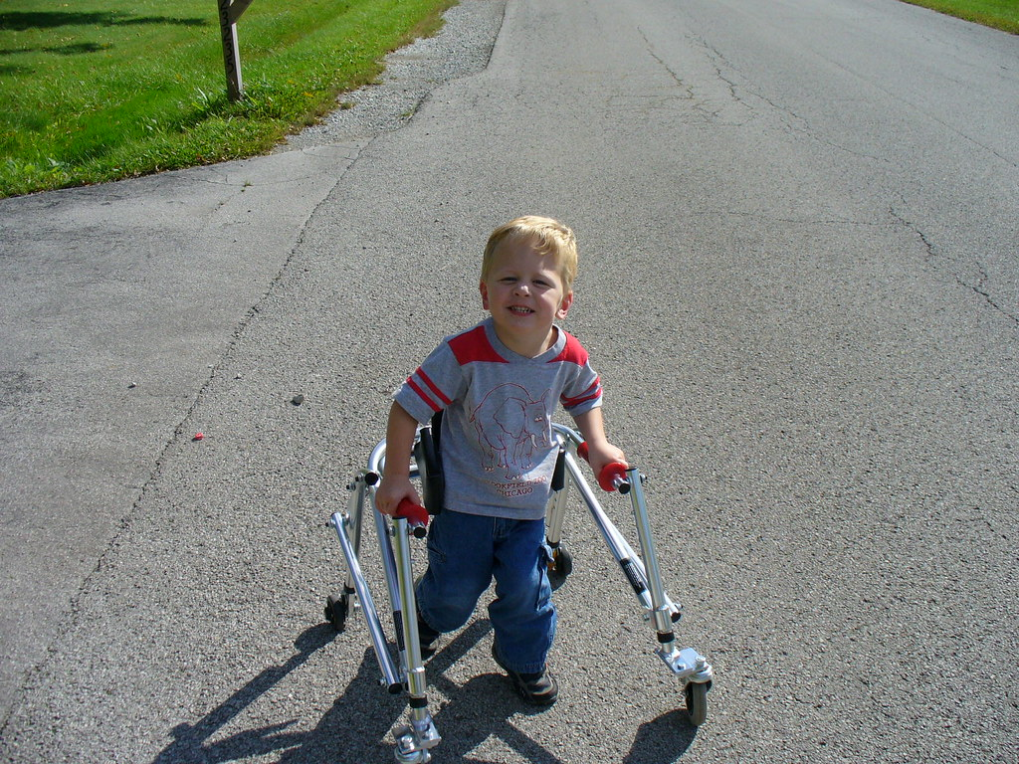
Population Served (Cont’d)
Related disability:
Severe, chronic conditions which are found to be closely related to an intellectual disability or which require treatment similar to that required for individuals with an intellectual disability (e.g., cerebral palsy, epilepsy, etc.). Onset of a related disability must be diagnosed before the age of 22.
This Photo by Unknown Author is licensed under CC BY
Notes:
A related disability is defined as:
Severe, chronic conditions which are found to be closely related to an intellectual disability or which require treatment similar to that required for individuals with an intellectual disability (e.g., cerebral palsy, epilepsy, etc.).
Onset of a related disability must be diagnosed before the age of 22.

Slide 7
Requirements to Participate
In order to become enrolled in the ID/RD Waiver, a potential enrollee must meet the following requirements:
be allocated a waiver slot.
be given the option of receiving services in his/her home and community or in a facility.
be Medicaid enrolled or be eligible to receive South Carolina Medicaid.
have needs that can be met by the provision of waiver services.
meet ICF/IID Level of Care.
Notes:
In order to become enrolled in the ID/RD Waiver, a potential enrollee must meet the following requirements:
-be allocated a waiver slot.
-be given the option of receiving services in his/her home and community or in a facility.
-be Medicaid enrolled or be eligible to receive South Carolina Medicaid.
-have needs that can be met by the provision of waiver services.
-meet ICF/IID Level of Care.

Slide 8
Overview of Services
The following services may be funded by Medicaid through South Carolina's ID/RD Waiver based on assessed need:
Adult Attendant Care Services
Assistance with activities of daily living and personal care for those adult participants (age 21 or older) who are able to self-direct their care
Limited to 28 hours per week (28 combined hours of Adult Attendant Care, Adult Companion Services and Personal Care 2 Services)
Adult Companion Services
Non-medical care, supervision, and socialization provided to an adult (age 21 or older)
Limited to 28 hours per week (28 combined hours of Adult Attendant Care, Adult Companion Services and Personal Care 2 Services)
Adult Day Health Care Services
Care furnished to someone age 18 or older 5 or more hours per day for one or more days per week, in a licensed outpatient setting, encompassing both health and social services
Notes:
Each approved waiver document specifies the services that are available through that waiver and includes applicable limitations on those services.
The following services may be funded by Medicaid through South Carolina's ID/RD Waiver based on assessed need:
Adult Attendant Care Services
Assistance with activities of daily living and personal care for those adult participants (age 21 or older) who are able to self-direct their care
limited to 28 hours per week (28 combined hours of Adult Attendant Care, Adult Companion Services and Personal Care 2 Services)
Adult Companion Services
Non-medical care, supervision, and socialization provided to an adult (age 21 or older)
limited to 28 hours per week (28 combined hours of Adult Attendant Care, Adult Companion Services and Personal Care 2 Services)
Adult Day Health Care Services
Care furnished to someone age 18 or older 5 or more hours per day for one or more days per week, in a licensed outpatient setting, encompassing both health and social services

Slide 9
Overview of Services (Cont’d)
Adult Vision Services
Extension of the State Plan Medicaid benefit for adult participants (21 or older)
Details are found in the Physician’s Provider manual on the SC DHHS website
Audiology Services
Extension of the State Plan Medicaid benefit for adult participants (21 or older)
Details are found in the Private Rehabilitative Therapy and Audiological Services manual on the SC DHHS website
Behavior Support Services
Services to assist people who exhibit problem behaviors to teach new appropriate behaviors and improve their quality of life
Notes:
Adult Vision Services
Extension of the State Plan Medicaid benefit for adult participants (21 or older).
Details are found in the Physician’s Provider manual on the SC DHHS website.
Audiology Services
Extension of the State Plan Medicaid benefit for adult participants (21 or older)
Details are found in the Private Rehabilitative Therapy and Audiological Services manual on the SC DHHS website.
Behavior Support Services
Services to assist people who exhibit problem behaviors to teach new appropriate behaviors and improve their quality of life.

Slide 10
Overview of Services (Cont’d)
Adult Day Health Care Nursing
Skilled nursing services are provided in ADHC center; limited to ostomy care, urinary catheter care, decubitus/wound care, tracheotomy care, tube feedings and nebulizer treatment
Adult Dental Services
Extension of the State Plan Medicaid benefit for adult participants (21 or older)
Details are found in the DentaQuest Healthy Connections manual on the SCDHHS website
Notes:
Adult Day Health Care Nursing
Skilled nursing services are provided in ADHC center; limited to ostomy care, urinary catheter care, decubitus/wound care, tracheotomy care, tube feedings and nebulizer treatment
Adult Dental Services
Extension of the State Plan Medicaid benefit for adult participants (21 or older).
Details are found in the DentaQuest Healthy Connections manual on the SCDHHS website.

Slide 11
Career Preparation Services
Services aimed at preparing participants for careers through teaching such concepts as compliance, attendance, task completion, problem solving, and safety
Community Services
Services aimed at developing one’s awareness of and participation in the community through exposure to and experiences in the community
Day Activity
Activities and services provided to enable participants to achieve, maintain, improve or decelerate the loss of personal care, social or adaptive skills
Notes:
Career Preparation Services
Career Preparation Services are time-limited and aimed at preparing individuals for competitive employment. These services can include experiences and exposure to careers and teach such concepts as attendance, task completion, problem solving, interpersonal relations and safety as outlined in the individual’s person-centered plan. Services are designed to create a path to integrated community-based employment for which an individual is compensated at or above minimum wage. On site attendance at the licensed facility is not required to receive services that originate from the facility. The cost for transportation is included in the rate paid to the provider.
Community Services
Services aimed at developing one’s awareness of and participation in the community through exposure to and experiences in the community
Day Activity
Activities and services provided to enable participants to achieve, maintain, improve or decelerate the loss of personal care, social or adaptive skills.

Slide 12
Employment Services
Intensive, on-going supports for participants for whom competitive employment at or above minimum wage is unlikely absent the provision of supports
Environmental Modifications
Physical adaptations to the participant’s home which are necessary to ensure the safety of the participant (e.g., installation of ramps and grab-bars)
Lifetime limit is $15,000 per participant
Independent Living Skills
Services that develop, maintain and improve the community-living skills of a waiver participant
Nursing Services
Skilled services provided within the scope of the South Carolina Nurse Practice Act, as ordered by a physician and deemed medically necessary
The limit is 56 hours/week of LPN services or 42 hours/week of RN services
Notes:
Employment Services
Intensive, on-going supports for participants for whom competitive employment at or above minimum wage is unlikely absent the provision of supports
Environmental Modifications
Physical adaptations to the participant’s home which are necessary to ensure the safety of the participant
Independent Living Skills
Services that develop, maintain and improve the community-living skills of a waiver participant. The services include direct training from a qualified staff person to address the identified skill development needs of a waiver participant in the areas of communication skills, community living and mobility, interpersonal skills, reduction/elimination of problem behavior, self-care and sensory/motor development involved in acquiring functional skills.
Nursing Services
Skilled services provided within the scope of the South Carolina Nurse Practice Act, as ordered by a physician and deemed medically necessary.

Slide 13
Personal Care 2 Services
Hands on assistance in the performance of Activities of Daily Living (ADLs) for participants aged 21 or older. Assisting with ADLs may include eating, bathing, dressing, toileting, transferring, maintaining continence, and assistance with ambulation.
Limited to 28 hours per week (28 combined hours of Adult Attendant Care Services, Adult Companion Services and Personal Care 2 Services)
Personal Care 1 Services
Assistance with instrumental activities of daily living (IADLs) such as light housework, laundry and meal preparation
Limited to 6 hours per week
Personal Emergency Response System (PERS)
An electronic device that enables participants at high risk of institutionalization to secure help in an emergency
Limited to those participants who live alone or who are alone in their own home for significant parts of the day or night and who would otherwise require extensive routine supervision
Notes:
Personal Care 2 Services
Hands on assistance in the performance of Activities of Daily Living (ADLs) for participants age 21 or older. Assisting with ADLs may include: eating, bathing, dressing, toileting, transferring, maintaining continence, and assistance with ambulation. Children’s Personal Care Services (CPCA) are available through State Plan Medicaid for those individuals under age 21
Personal Care 1 Services
Assistance with instrumental activities of daily living (IADLs) such as light housework, laundry and meal preparation.
Personal Emergency Response System (PERS)
An electronic device that enables participants at high risk of institutionalization to secure help in an emergency.
This service is limited to those participants who live alone or who are alone in their own home for significant parts of the day or night and who would otherwise require extensive routine supervision.

Slide 14
Pest Control Treatment and Pest Control Bed Bugs
Aid in maintaining an environment free of insects such as roaches and other potential disease carriers to enhance safety, sanitation, and cleanliness of the participant’s home/or residence
Private Vehicle Modifications and Private Vehicle Modification Consultations
Modifications to a privately owned vehicle used to transport the participant (i.e., installation of a lift, tie downs, lowering the floor of the vehicle, raising the roof, etc.)
Limit of $7,500 per vehicle with a lifetime cap of 2 vehicles
Residential Habilitation Services
Care, supervision and skills training provided to a person in a non-institutional setting. Services furnished as Residential Habilitation must support the person to live as independently as possible in the most integrated setting that
Is appropriate to his/her needs.
Notes:
Pest Control Treatment and Pest Control Bed Bugs
Aid in maintaining an environment free of insects such as roaches and other potential disease carriers to enhance safety, sanitation, and cleanliness of the participant’s home/or residence.
Private Vehicle Modifications and Private Vehicle Modification Consultations
Modifications to a privately owned vehicle used to transport the participant (e.g., installation of a lift, tie downs, lowering the floor of the vehicle, raising the roof, etc.)
Residential Habilitation Services
Residential Habilitation is the care, supervision and skills training provided to a person in a non-institutional setting. The type, scope and frequency of care, supervision, and skills training to be furnished are described in the person’s service plan and are based on his/her assessed needs and preferences. Services furnished as Residential Habilitation must support the person to live as independently as possible in the most integrated setting that is appropriate to his/her needs.

Slide 15
Respite Care
Care provided on a short-term basis because of the absence or need for relief of those persons normally providing the care
Limited to 68 hours per month
Specialized Medical Equipment, Supplies and Assistive Technology and Consultations
Includes items necessary for life support, remote supports, ancillary supplies and equipment necessary to the proper functioning of such items, and durable and non-durable medical equipment not available under the Medicaid State Plan
Support Center Services
Non-medical care, supervision and assistance provided in a non-institutional, group setting
Notes:
Respite Care
Care provided on a short-term basis because of the absence or need for relief of those persons normally providing the care
Specialized Medical Equipment, Supplies and Assistive Technology and Consultations
Specialized medical equipment, supplies and assistive technology to include devices, controls, or appliances, specified in the plan of care which enable individuals to increase their abilities to perform activities of daily living or to perceive, control, or communicate with the environment in which they live. This service also includes items necessary for life support, remote supports, ancillary supplies and equipment necessary to the proper functioning of such items, and durable and non-durable medical equipment not available under the Medicaid State Plan. Items reimbursed with waiver funds shall be in addition to any medical equipment and supplies furnished under the State Plan and shall exclude those items which are not of direct medical or remedial benefit to the individual. All items shall meet applicable standards of manufacture, design and installation.
Support Center Services
Non-medical care, supervision and assistance provided in a non-institutional, group setting

Slide 16
Incontinence Supplies
Diapers, underpads, wipes, liners, and disposable gloves provided to participants who are at least twenty-one (21) years old and who are incontinent of bowel and/or bladder according to the established medical criteria.
Waiver Case Management (WCM)
Services that assist participants in gaining access to needed waiver and other State Plan services, as well as medical, social, education and other services, regardless of the funding sources for the services to which access is gained.
Transitional Waiver Case Management
Typically, WCM shall only be provided to participants who are residing in a community setting. However, as an exception, WCM may also be provided to a participant transitioning to a community setting following an institutional stay (i.e., nursing home, in-patient psychiatric hospital, ICF/IID or PRTF).
Notes:
Incontinence Supplies
Diapers, underpads, wipes, liners, and disposable gloves provided to participants who are at least twenty-one (21) years old and who are incontinent of bowel and/or bladder according to the established medical criteria.
Incontinence Supplies are available through State Plan Medicaid for those individuals under age 21.
Waiver Case Management
Services that assist participants in gaining access to needed waiver and other State plan services, as well as medical, social, education and other services, regardless of the funding sources for the services to which access is gained
Transitional Waiver Case Management
Typically, WCM shall only be provided to participants who are residing in a community setting. However, as an exception, WCM may also be provided to a participant transitioning to a community setting following an institutional stay (e.g., nursing home, in-patient psychiatric hospital, ICF/IID or PRTF).

Slide 17
Wait List Management
A potential enrollee may meet the requirements and other conditions to enroll in the ID/RD Waiver, but a slot may not be available. If that is the case, the applicant will be placed on a waiting list based on the earliest referral date.
This Photo by Unknown Author is licensed under CC BY
Notes:
A potential enrollee may meet the requirements and other conditions to enroll in the ID/RD Waiver, but a slot may not be available. If that is the case, the applicant will be placed on a waiting list based on the earliest referral date.

Slide 18
Reserved Capacity
A slot has been reserved in the waiver for the applicants who fall in the following categories. These applicants will be given priority and may be enrolled in the ID/RD waiver without being placed on a waiting list:
Those discharged from an ICF/IID; the enrollment process must begin within 30 days of discharge.
Children in SCDSS custody for whom SCDSS has agreed to sponsor ID/RD Waiver enrollment.
Those applicants who reside in or need DDSN-sponsored residential placement in order to receive waiver supports and services.
Those participants enrolled in the Community Supports Waiver who have anticipated, long term/ongoing needs that will exceed the individual cost limit of the Community Supports Waiver.
When waiver services are needed to prevent serious and imminent harm.
Eligible family members of a member of the armed services who maintain a South Carolina residence.
Notes:
A slot has been reserved in the waiver for the applicants who fall in the following categories. These applicants will be given priority and may be enrolled in the ID /RD waiver without being placed on a waiting list:
Those discharged from an ICF/IID; the enrollment process must begin within 30 days of discharge.
Children in SCDSS custody for whom SCDSS has agreed to sponsor ID/RD Waiver enrollment.
Those applicants who reside in or need DDSN-sponsored residential placement in order to receive waiver supports and services.
Those participants enrolled in the Community Supports Waiver who have anticipated, long term/ongoing needs that will exceed the individual cost limit of the Community Supports waiver.
When waiver services are needed to prevent serious and imminent harm
Eligible family members of a member of the armed services who maintains a South Carolina residence

Slide 19
Resources
This Photo by Unknown Author is licensed under CC BY-SA
All waiver services, policies and procedures are housed on the SCDDSN website (www.SCDDSN.gov)
Notes:
No need to feel overwhelmed. All waiver services, policies and procedures are housed on the SCDDSN website (www.SCDDSN.gov) and can be accessed when needed.

