Slide 1

Person-Centered Planning
Version 1.0 (07/01/20)

Slide 2


What is Person-Centered Planning?
Services
Support
Interventions
Community Participation
--
Wellness
Dignity
Respect
Independence
Education
Employment
Notes:
Person-centered planning is a framework that provides services, supports and interventions that is directed by the participant and meets the individual’s, family’s or legal guardian’s long-term support needs. The Case Management assessment and plan honors the participant’s goals and aspirations for a lifestyle that promotes dignity, respect, interdependence, education, employment, community participation, wellness and relationship opportunities. This is done by utilizing Person Centered Thinking in order to create community connections and encourage the use of natural and community supports to assist in ending isolation and disconnections.

Slide 3





Creating a Plan
GOALS
INTERESTS
RELATIONSHIPS
PERSON
CENTERED
PLANNING
ABILITIES
SKILLS
SUPPORTS
Notes:
The use of Person-Centered Thinking techniques and a Person-Centered Description empowers the individual by creating a plan that views the individual, family or legal guardian in the context of their culture and in the context of plain language. All elements that compose a person’s individuality and a family’s uniqueness are acknowledged and valued in the planning process. Person-Centered Planning supports mutually respectful partnerships between individuals, families or legal guardians and provider or professionals and recognizes the legitimate contributions of all parties involved.

Slide 4

Basic Beliefs
Dreams
Desires
Preferences
Individual Input
Additional Information
Desired Future
Notes:
The basic beliefs of Person-Centered Planning are:
The person’s desired future will become the framework for all planning. The most important part of this process is the dreams, desires and preferences of the individual. Planning begins with input from the individual and will also be decided by and include additional information from the people most important to the individual, and as appropriate, information from professionals.

Slide 5
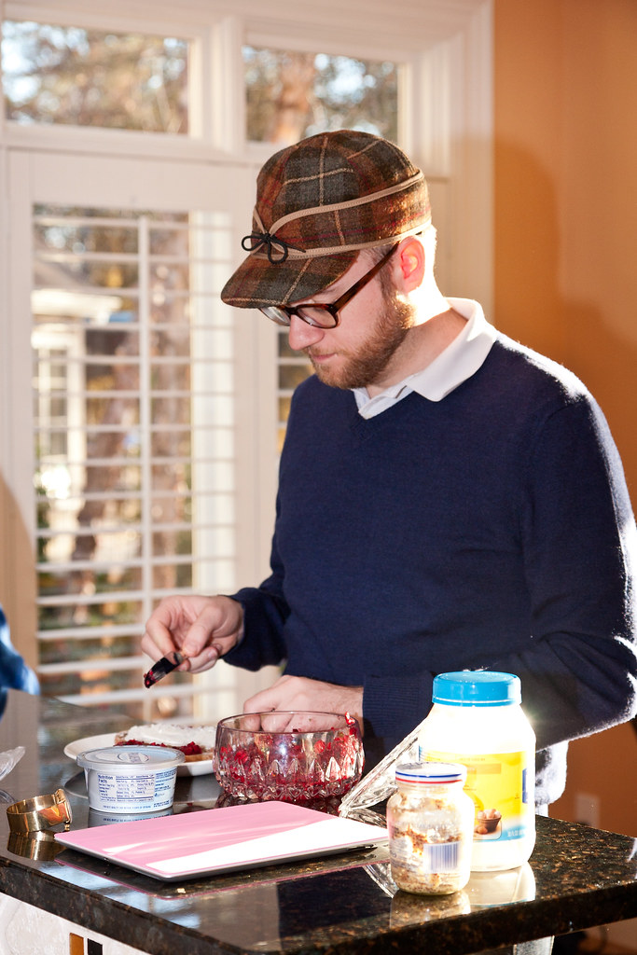
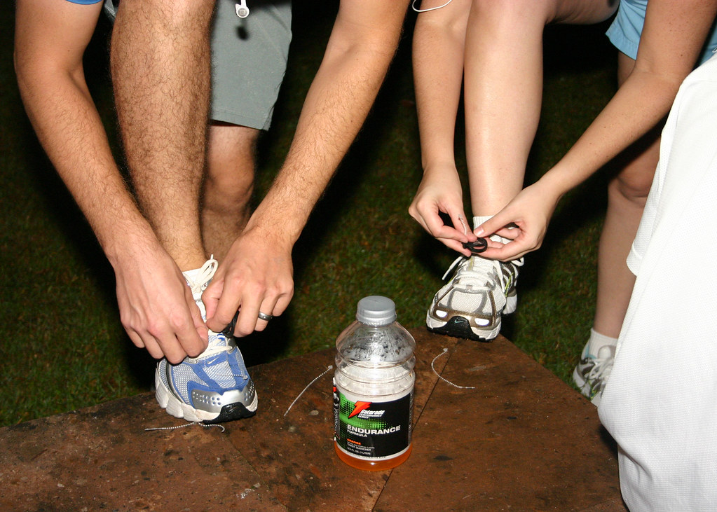



Net Planning Process
Friends
Community
Family
“I can tie my own shoes”
"Adrian Makes a Sandwich" by handcoding is licensed under CC BY-NC 2.0
“I can make my own sandwich”
"IMG_4294" by toniwbusch is licensed under CC BY-NC-SA 2.0
Notes:
A net planning process will be used for Person-Centered Planning. For example, the plan of service begins with what the individual can do for him or herself. Then it adds resources and support from family, neighbors, friends and other community resources. Formal public supports and services are utilized as a last resort. Planning activities will address issues and concerns which the individual or others have about health, welfare and safety.

Slide 6
The Whole Person
DAILY ACTIVITIES
PERSON
SERVED
PHYSICAL HEALTH
LIFE
SKILLS
COMMUNITY SUPPORT
MENTAL
HEALTH
HOPES
&
DREAMS
MEANINGFUL
RELATIONSHIPS
Notes:
Person-Centered plans will change any time the person’s needs, desires and circumstances change. A Person-Centered approach will seek feedback from the individual, on a regular basis, regarding their interests and needs.

Slide 7


Questions to Think About
Who is here to help me plan my life?
What are important events that have happened to
me so far in my life?
Who are the people that are most important to me?
What are the places most important to me?
What obstacles may keep me from enjoying more of
these people and places?
What are my likes and dislikes?
What are activities I enjoy doing?
"BASE/Metabronx Apprentices in Midbronx Senior Center"
by juan tan kwon is licensed under CC BY-NC-ND 2.0
Notes:
When putting together a plan, the person will have to think about the people who can help them plan for the future, events and people that are important to them, things that might get in the way and keep them from enjoying more of these people and places, their likes and dislikes, and what activities they enjoy doing. Questions may include:
Who is here to help me plan my life? What are important events that have happened to me so far in my life? Who are the people that are most important to me? What are the places most important to me? What obstacles may keep me from enjoying more of these people and places? What are my likes and dislikes? And what are activities I enjoy doing?

Slide 8






Planning Process
Assist
Access Needed Services
Support During Planning
Notes:
The Person-Centered planning process should include family members, legal guardians, friends, caregivers and others the person or his/her representative wishes to include. The role of agency workers, such as waiver case manager, is to assist people to identify and access the services they need and to provide support during planning. Person-centered planning should involve the individual receiving services and supports to the maximum extent possible, even if the person has a legal representative.

Slide 9




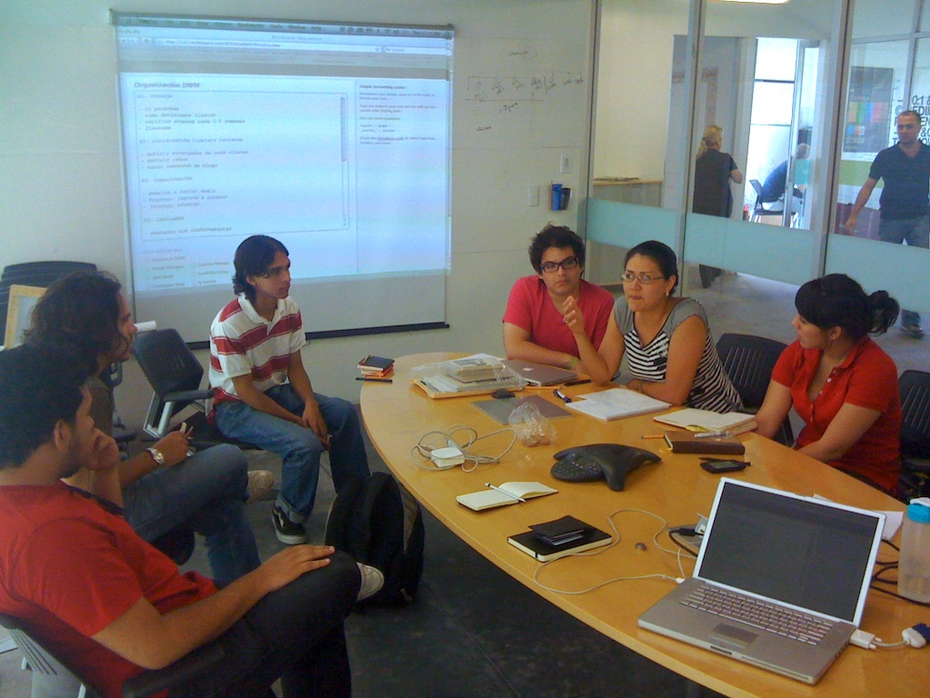
Case Management Plan
Case
Management
Plan
"DWM10 Planning" by sincretic is licensed under CC BY-NC-SA 2.0
Notes:
Waiver Case Management providers use the information obtained by all parties involved in order to develop a person-centered Case Management plan. Waiver Case Management providers will ensure that the meeting time and place maximize participation by individuals important to the person and that the person is the focal point of the planning process. Comments, questions and statements are to be addressed to the person, whether the person verbally communicates or not.

Slide 10
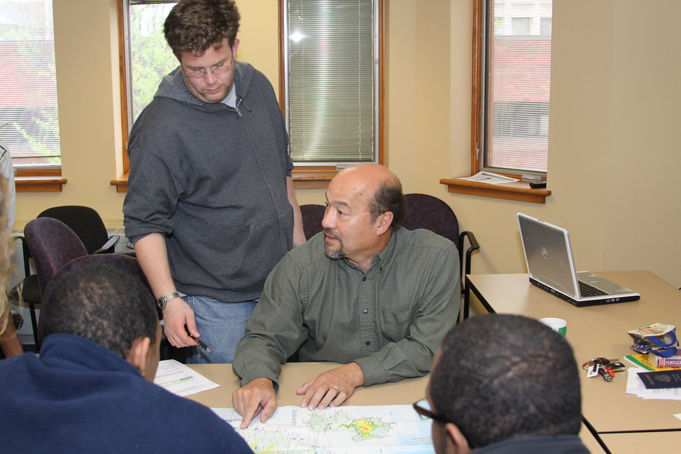


Case Management Plan (cont’d)
CONSULTANT
ADVISOR
"Sao Tome Planning" by Wwing49 is licensed under CC BY-NC 2.0
hopes
ambitions
dreams
desires
wishes
Notes:
Waiver Case Management providers will ensure that the person’s input is held as primary, and all other participants act as consultants and advisors rather than decision makers. Waiver Case Management providers will also ensure that the language used in the meeting can be clearly understood by all and is kept positive; that the individual has all the information needed to make choices and has time to communicate them. The focus of planning is on the dreams and desires of the person.

Slide 11



Confirmation of Agreement
Services
Supports
Qualified Service Providers
Family
Caregiver
Provider
Other
The
Plan
Participant
Friend
Notes:
The participant receiving services is required to sign and date the Case Management Plan indicating confirmation of the agreement with the services and supports detailed in the Plan and choice of qualified service providers. All individuals and providers involved are encouraged to sign the Case Management Plan confirming participation and agreement with the services and supports as detailed in the Plan. The participant or legal guardian will receive a copy of the Plan upon completion and additional copies will also be provided to participating qualified service providers if the participant or legal guardian requests it.

Slide 12

Confirmation of Agreement
Notes:
This concludes the Person-Centered Planning annual training. Please see your Supervisor for any questions or concerns.

