Slide 1
HIPAA CONFIDENTIALITY ABUSE, NEGLECT AND EXPLOITATION
Version 2.0 (7/1/2022)

Slide 2
What is HIPAA?
In 1996, the Health Insurance Portability and Accountability Act or the HIPAA was endorsed by the U.S. Congress.
The HIPAA Privacy Rule provided the first nationally-recognizable regulations for the use/disclosure of an individual's health information.
This Photo by Unknown Author is licensed under CC BY-SA-NC
Notes:
What is HIPAA?
In 1996, the Health Insurance Portability and Accountability Act, or the HIPAA, was endorsed by the U.S. Congress. The HIPAA Privacy Rule provided the first nationally-recognizable regulations for the use/disclosure of an individual's health information. Essentially, the Privacy Rule defines how covered entities use individually-identifiable health information or the PHI (Personal Health Information).

Slide 3
Privacy Rule
The Privacy Rule, introduced in 2003, gave a definition of what is to be treated as “Protected Health Information” (commonly referred to as PHI).
This definition includes any piece of information that could be viewed as “Individually Identifiable Health Information” (IIHI).
Keeping PHI
SAFE
Notes:
The Privacy Rule, introduced in 2003, gave a definition of what is to be treated as “Protected Health Information” (commonly referred to as PHI). This definition includes any piece of information that could be viewed as “Individually Identifiable Health Information” (IIHI), i.e., can be used to identify a patient.

Slide 4
What are Examples of PHI?
COMMUNICATIONS BETWEEN HEALTH CARE PROFESSIONALS
PHOTOGRAPHS
BILLING RECORDS
MEDICAL CHARTS
POLICY NUMBERS
CLAIMS RECORDS
This Photo by Unknown Author is licensed under CC BY-SA-NC
Notes:
Some examples of PHI include claims records, medical charts, photographs, communications between health care professionals, billing records, and policy numbers.

Slide 5
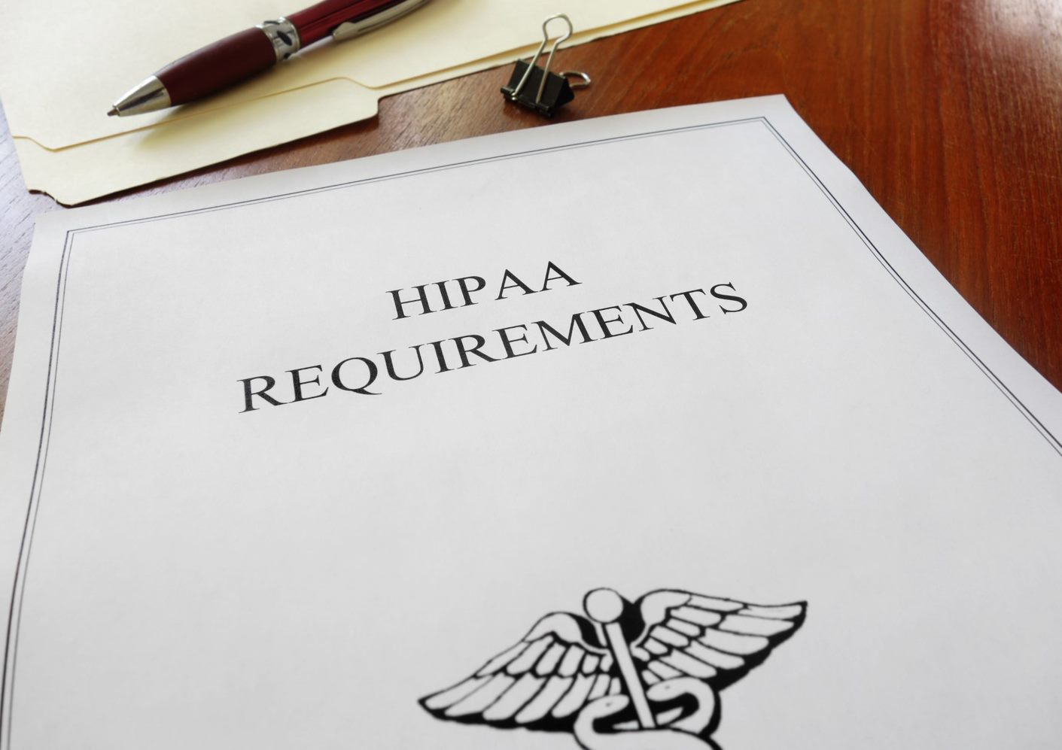
Who Needs Training and Why?
HIPAA
Regulations
Policies and procedures
PHI Training
Today
Notes:
Employees who come in contact with “Protected Health Information” (PHI) are Federally required to attend training. This presentation is designed to familiarize you with HIPAA regulations, policies and procedures regarding protected health information and ensure Federal compliance.

Slide 6
Who Helps Regulate PHI?
HIPAA Privacy Officer/Chief Privacy Officer (CPO)
The HIPAA Security Rule mandates that every practice or health care organization that creates, stores, or transmits ePHI, must designate a privacy compliance officer regardless of their size.
Notes:
If any direct or indirect identifiers are present, the information is PHI and subject to HIPAA protection. Information can be “deidentified” – but the Privacy Officer must review to ensure all direct and indirect identifiers have been properly removed.
A HIPAA privacy officer–sometimes called a chief privacy officer (CPO)–oversees the development, implementation, maintenance of, and adherence to privacy policies and procedures regarding the safe use and handling of protected health information (PHI) in compliance with federal and state HIPAA regulation. The HIPAA Security Rule mandates that every practice or health care organization that creates, stores, or transmits ePHI, must designate a privacy compliance officer regardless of their size.

Slide 7
Examples of Direct/Indirect Identifiers
Names
Telephone Numbers
Addresses
Device Serial Numbers
Photographs
Social Security Numbers
Fax Numbers
Email Addresses
Medical Records
Health Insurance Numbers/IDs
Account Numbers
Certificate or License Numbers
Notes:
Examples of Direct or Indirect identifiers include:
Name (including middle names, aliases and previous names)
Telephone numbers (work, cell and home)
Addresses or geographical information smaller than the State level (however the first three digits of a zip code are not considered to be PHI)
Social Security numbers
Fax Numbers
Email addresses
Medical records
Health insurance numbers/beneficiary numbers
Account numbers (e.g., bank account)
Certificate or license numbers
Device serial numbers and
Photographs

Slide 8
How HIPAA Protects PHI
A central aspect of the Privacy Rule is the principle of “minimum necessary” use and disclosure.
HIPAA limits who may use or disclose PHI
Limits the purpose for which PHI may be used or disclosed
Limits the amount of information that may be used or disclosed (Minimum Necessary rule)
Requires use of safeguards over how PHI is used, stored and disclosed
This Photo by Unknown Author is licensed under CC BY-NC-ND
Notes:
A central aspect of the Privacy Rule is the principle of “minimum necessary” use and disclosure. A covered entity must make reasonable efforts to use, disclose, and request only the minimum amount of protected health information needed to accomplish the intended purpose of the use, disclosure, or request.
HIPAA limits who may use or disclose PHI, limits the purpose for which PHI may be used or disclosed, limits the amount of information that may be used or disclosed (minimum necessary rule), and requires use of safeguards over how PHI is used, stored and disclosed.

Slide 9
This Photo by Unknown Author is licensed under CC BY-SA-NC
Notes:
Misusing PHI can result in disciplinary action, legal penalties and loss of trust. When using PHI, try to think about:
Where you are
Who might overhear
Who might see

Slide 10
Avoid!
Discussing PHI in front of others who do not need to know.
Leaving records accessible to coworkers or others who don’t need to see them
Positioning monitors where others can view them
Using printers located in public or unsecured areas
Saving information on a CD, floppy disk, USB thumb drive or other removable media
Posting pictures of work setting on social media
This Photo by Unknown Author is licensed under CC BY-SA
Notes:
Also try to avoid:
Discussing PHI in front of others who do not need to know.
Leaving records accessible to coworkers or others who don’t need to see them
Positioning monitors where others can view them
Using printers located in public or unsecured areas
Saving information on a CD, floppy disk, USB thumb drive or other removable media, and
Posting pictures of work setting on social media

Slide 11
You Should….
Use fax cover
Encrypt emails
Use shredding bins
Notes:
When using PHI, you should:
-use a fax cover page when faxing PHI,
-use encryption when sending emails containing PHI and
-use shredding bins to dispose of paper records containing PHI when it is no longer needed.

Slide 12
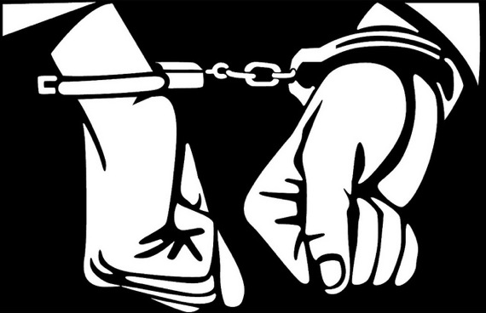
What are the Consequences?
May face a criminal penalty of up to $50,000 and up to 1 year imprisonment.
The criminal penalties increase to $100,000 and up to 5 years imprisonment if the wrongful conduct involves false pretenses, and to $250,000 and up to 10 years imprisonment if the wrongful conduct involves the intent to sell, transfer, or use identifiable health information for commercial advantage, personal gain or malicious harm.
This Photo by Unknown Author is licensed under CC BY-SA
Notes:
If you misuse PHI, you may face a criminal penalty of up to $50,000 and up to one-year imprisonment.
The criminal penalties increase to $100,000 and up to five years imprisonment if the wrongful conduct involves false pretenses, and up to $250,000 and up to 10 years imprisonment if the wrongful conduct involves the intent to sell, transfer, or use identifiable health information for commercial advantage, personal gain or malicious harm.

Slide 13
What are the Consequences? (Cont’d)
Dignity
Respect
Safe
Free of abuse, neglect, or exploitation
This Photo by Unknown Author is licensed under CC BY-SA
Notes:
People have a right to be treated with dignity and respect and to receive services and supports in an environment that is safe and free of abuse, neglect, or exploitation. Abuse, neglect, or exploitation is strictly prohibited.
South Carolina state law requires the reporting of any suspected abuse, neglect, or exploitation. The Child Protection Reform Act requires the reporting of any suspected abuse or neglect occurring to a child, age 17 and under. The Omnibus Adult Protection Act requires the reporting of suspected abuse, neglect, or exploitation of a vulnerable adult, age 18 and above.

Slide 14
What is a Vulnerable Adult?
This Photo by Unknown Author is licensed under CC BY-ND
Any person, age 18 and above, who has a physical or mental condition that substantially impairs the person from adequately providing for his/her own care or protection.
A resident of a facility or a person, age 18 and above receiving services from a contracted provider agency is considered a vulnerable adult.
Notes:
A vulnerable adult is defined as any person, age 18 and above, who has a physical or mental condition that substantially impairs the person from adequately providing for his/her own care or protection. A resident of a facility or a person, age 18 and above receiving services from a contracted provider agency is considered a vulnerable adult.

Slide 15
What is a Vulnerable Adult? (Cont’d)
Waiver Case Management providers are all mandated reporters and are required to report any suspected Abuse, Neglect, or Exploitation (ANE) in accordance with agency policy and state law.
Failure to report may constitute abuse and may result in termination of employment and prosecution.
This Photo by Unknown Author is licensed under CC BY-SA
Notes:
Waiver Case Management providers are all mandated reporters and are required to report any suspected abuse, neglect, or exploitation in accordance with agency policy and state law. Failure to report may constitute abuse and may result in termination of employment and prosecution.
Training for people receiving services/supports in reporting abuse, neglect or exploitation and how to recognize and avoid dangerous situations must be provided and documented in the consumer’s file at least annually by the case management provider and/or by the residential services provider. A copy of the documentation must exist in both files.
Reporters shall make the report directly to the appropriate State Investigative Agency.

Slide 16
Abuse, Neglect and Exploitation Training
To ensure statewide consistency in the
overall content of training, the South Carolina
Department of Disabilities and Special Needs
(SCDDSN) requires the use of training materials
developed by the USC Children’s Law Center
and the Adult Protection Coordinating Council
(APCC).
http://www.ddsn.sc.gov
This Photo by Unknown Author is licensed under CC BY-SA
Notes:
Waiver case managers shall receive training in their legal responsibilities to report suspected abuse, neglect, or exploitation and prevention of abuse. To ensure statewide consistency in the overall content of training, the South Carolina Department of Disabilities and Special Needs (SCDDSN) requires the use of training materials developed by the USC Children’s Law Center and the Adult Protection Coordinating Council (APCC), in addition to this Directive.
The USC Children’s Law Center training and the APCC Omnibus Adult Protection Act training PowerPoint presentations may be accessed through the SCDDSN Website at http://www.ddsn.sc.gov.

Slide 17
A.N.E. Training (Cont’d)
Additional resources may be found on the National Center on Elder Abuse Website:
http://www.ncea.aoa.gov/Resources/Publication/docs/NCEA_LTCF_ResearchBrief_2013.pdf
http://www.ncea.aoa.gov/Resources/Publication/docs/NCEA_WhatYouMustKnow2013_508.pdf
Notes:
Additional resources may include resources from the National Center on Elder Abuse: http://www.ncea.aoa.gov/Resources/Publication/docs/NCEA_LTCF_ResearchBrief_2013.pdf
and http://www.ncea.aoa.gov/Resources/Publication/docs/NCEA_WhatYouMustKnow2013_508.pdf.

