Slide 1

South Carolina Medicaid Waivers
Version 2.0 (07/01/2022)

Slide 2

Waiver Case Management
Welcome to Waiver Case Management Training!
Notes:
Welcome to Waiver Case Management Training! This training is designed to familiarize you with Medicaid Waivers, your role as a waiver case manager, and the process you will use to help waiver participants access needed services.

Slide 3

Training
This training encompasses a minimum of nine modules on different subjects that are extremely important in your work as a waiver case manager (WCM).
At the end of each training module, you must take a quiz to assess how much you learned on the subject matter of that module.
Module 1
Quiz
Notes:
This training encompasses a minimum of nine modules on different subjects that are extremely important in your work as a waiver case manager.
At the end of each training module, you must take a quiz to assess how much you learned on the subject matter of that module.

Slide 4


Training (Cont’d)
You must score 80% or better to pass each quiz.
Notes:
You must score 80% or better to pass each quiz.

Slide 5

Training (Cont’d)
If you do not pass a quiz, you will need to meet with your Supervisor to discuss your options.
Notes:
If you do not pass a quiz, you will need to meet with your Supervisor to discuss your options.

Slide 6

Your Role as a Waiver Case Manager
Your Supervisor is your first and best source of information as you learn about your role as a waiver case manager.
There will also be a section on resources
later in the training. It will provide you
with information on state resources, and
some local ones, to help you do your job
serving waiver participants better.
Good luck!
Supervisor
Notes:
Should you have any questions about the content covered, please write them down to discuss with your Supervisor after you complete the module.
Your Supervisor is your first and best source of information as you learn about your role as a waiver case manager.
There will also be a section on resources later in the training. It will provide you with information on state resources, and some local ones, to help you do your job serving waiver participants better.

Slide 7

South Carolina Medicaid Waivers
What is Medicaid?
Notes:
As a Medicaid waiver case manager, you will be working with participants who are eligible for services within a Medicaid Waiver. However, you may be asking,
“What is Medicaid?”

Slide 8
Medicaid vs. Medicare
Title XIX of the Social Security Act
Medicaid Medicare
An individual can have both Medicare and Medicaid if he or she meets the eligibility requirements for both programs.
South Carolina’s aid program
federal and state governments share the cost of providing medical care
Age 65 and over
or
Received social security disability benefits
Notes:
A simple definition of Medicaid is:
South Carolina's aid program by which the federal and state governments share the cost of providing medical care for needy persons who have low income.
Medicaid was created in Title XIX of the Social Security Act. It is important to note that Medicaid and Medicare are not the same thing. They are two different programs:
Medicare is a health insurance program for all people age 65 and over or who have received Social Security disability benefits for a minimum of 24 months.
An individual can have both Medicare and Medicaid if he or she meets the eligibility requirements for both programs.
As a waiver case manager, it is important for you to be aware of benefits and/or programs participants are receiving since this could impact how their services are paid for.

Slide 9
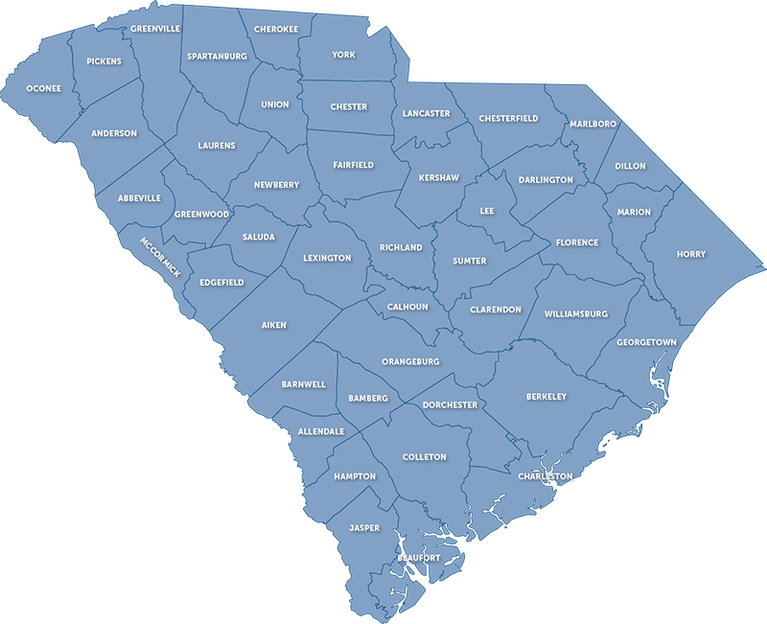

Single State Agency
South Carolina Department of Health and Human Services
Medicaid State Plan
-Eligibility standards
-Scope of services
-Rate of payment
Notes:
As you can imagine, the Federal Government has many requirements for states that choose to participate in the Medicaid program.
First, each state must have one “Single State Agency” who is responsible for administering or supervising the administration of the Medicaid program. The South Carolina Department of Health and Human Services (SCDHHS) is that single state agency.
Second, to receive federal dollars, the state is required to have a State Plan that outlines how the state will administer Medicaid to those who qualify, and to have matching state dollars to support the Plan.
Each state designs its own Medicaid State Plan to best fit and meet the needs of the citizens of that state. South Carolina’s State Medicaid is called “Healthy Connections”.
The Medicaid State Plan outlines the nature and scope of services that are available to those citizens eligible to receive Medicaid.
Each state determines its own eligibility standards (a person who is eligible for Medicaid in one state may not be eligible in another state), the type, amount, duration and scope of services covered within federal guidelines, services can differ state to state, and the rate of payment for services with CMS approval.

Slide 10


Eligibility
Age 19
U.S.
AND
65 or older
SC
https://www.scdhhs.gov/Getting-Started
Notes:
To be eligible for South Carolina “Healthy Connections Medicaid”, a person must meet all of the following criteria:
“Their income and resources must be at or below certain income limits”,
“They must meet U.S. citizenship guidelines”, and
“The individual must also reside in the state.”
A person must also meet at least one of the following criteria:
“Under the age of 19”
“Age 65 or older”
“A caretaker relative living with a child under the age of 18”
“Pregnant” or
“Totally or permanently disabled”
More eligibility information can be found in the Eligibility Manual on the SCDHHS website.
To provide services in alternative ways, the state can also apply to administer a Waiver Program in addition to their Medicaid State Plan.

Slide 11


What is a Waiver?
Provides long-term care services to people in their home rather than in an institution.
Notes:
This covers some very basic, introductory information about Medicaid. However, you may now be wondering,
“What is a waiver?”
Briefly, a Medicaid waiver is a program which permits a state to waive certain federal requirements to provide long-term care services to people in their home rather than in an institution.
A waiver is a vehicle that states can use to test new or existing ways to deliver and pay for health care services in Medicaid.
Here is a brief overview of Home and Community Based Waivers.

Slide 12


Home and Community Based Services (HCBS) Waivers
Intellectual Disability (ID) or
Related Disabilities (RD)
Head and Spinal Cord Injury (HASCI)
Notes:
Prior to 1981, people in need of long-term care services could only receive Medicaid funding for such services when the services were provided in an institutional setting such as a nursing facility.
In October 1981, the Social Security Act was amended to allow states to choose to offer Medicaid funding for long term care services when those services are provided in the person's home or community. This became known as the Home and Community Based Services Waiver or Medicaid Waiver option. Section 1915 (c) of Title XIX in the federal Social Security Act provides the legal authority for HCBS Waiver programs.
When the HCBS waiver option is selected by a state, the state is choosing to waive the institutional requirements and must decide for whom those requirements will be waived. The state can select the group or groups of people for whom they wish the requirements to be waived.
Some examples of target groups of people for whom these requirements may be waived are people who are elderly or disabled, people who have an intellectual disability or a related disability, or people who have a head or spinal cord injury.

Slide 13
HCBS Waiver Services
Prevent/delay institutionalization
Receive similar services
CMS
U.S. Department of Health and Human Services
24 hrs
Notes:
Medicaid HCBS Waiver services are designed to prevent or delay institutionalization.
Participants receive services similar, but not identical, to those available in a nursing facility or institution but are instead provided in a private home and/or community settings.
They may receive services that are an extension of the Medicaid State Plan or they may receive services that are unique to the HCBS Waiver program.
It is important to note that the Waiver programs are not intended to pay for 24-hour care or needs. Waiver services assist participants to live in the community utilizing all other identified resources including their own.
The federal Centers for Medicare and Medicaid Services (CMS) is responsible for approving and monitoring a state’s HCBS Waiver programs. CMS is a division within the U.S. Department of Health and Human Services.

Slide 14
Assurances to CMS
Participant
Institutional Care or Waiver
Reasonable service alternatives
Qualified Providers
Expenditures
Notes:
When a state elects to offer HCBS Waivers, they must make the following assurances to CMS:
-people are given choice between institutional care or Waiver services,
-people are informed of all reasonable service alternatives available under the Waiver program,
-people are given the choice of qualified providers of Waiver services,
-administration of the Waiver program is consistent with the application approved by CMS, and
-expenditures under the Waiver, in the aggregate, do not exceed the amount that would have been spent if the participants had chosen institutionalization.

Slide 15



Assurances to CMS (Cont’d)
Qualified Providers
LOC
Plan of
service
Notes:
The state must also assure that:
-there are safeguards to protect the health and welfare of each participant,
-each participant requires a level of care equivalent to that provided in an institution and the specified level of care is periodically re-evaluated,
-each participant has an individualized plan of service and there is a system for reviewing the service plan, and
-services are provided by qualified providers.
These assurances will be discussed in greater detail in the next module.

Slide 16



Why is a Waiver Important?
I can make my own choices
vs.
Approved services
Provider
Notes:
Waivers provide an alternative to institutionalization. Long-term care services can be provided to people in their homes or other community settings rather than in an institution.
Additionally, waivers allow people to make their own choices in where they live, what services they get based on approved services in the waiver and assessed need, and who will provide those services.
Allowing people to make choices to receive services in their home decreases the cost to Medicaid and increases participant satisfaction.

Slide 17


Who Operates Medicaid HCBS Waivers?
Notes:
The South Carolina Department of Health and Human Services is the Single State agency responsible for applying for, securing, and administering the waivers. However, it contracts with the South Carolina Department of Disabilities and Special Needs to manage the daily operations of three of the Medicaid HCBS Waivers through contracts with local service providers.
What is the difference between a Medicaid Waiver and the State Plan?
The State Plan addresses the nature and scope of services to individuals eligible to receive Medicaid benefits in South Carolina.
Home and Community Based Waivers are optional programs offered by the Medicaid Agency to address the long-term care needs and avoid institutionalization of certain target groups defined by the waivers.

Slide 18
Overview of South Carolina Waivers
Long Term Living (LTL)
HIV/AIDS
Mechanical Ventilator Dependent (VENT)
Community Choices (CC)
Medically Complex Children (MCC)
Palmetto Coordinated System of Care (PCSC)
Notes:
SCDHHS currently administers or supervises the administration of eight (8) §1915(c) HCBS waivers. Five (5) of those are operated by SCDHHS’ Long Term Living (LTL) Division. They are:
HIV/AIDS Waiver
Mechanical Ventilator Dependent Waiver
Community Choices Waiver
Medically Complex Children Waiver and
The Palmetto Coordinated System of Care Waiver

Slide 19
Waivers Operated by SCDDSN
Head and Spinal Cord Injury (HASCI)
Intellectual Disability/Related Disabilities (ID/RD)
Community Supports (CS)
https://www.scdhhs.gov
Notes:
The other three (3) waivers are administered by SCDHHS and operated by SCDDSN. They are:
Head and Spinal Cord Injury Waiver
Intellectual Disability/Related Disabilities Waiver and
The Community Supports Waiver
Information on these three (3) waivers will be provided in later modules.
Information about all of the waivers can be found on the SCDHHS website.

Slide 20
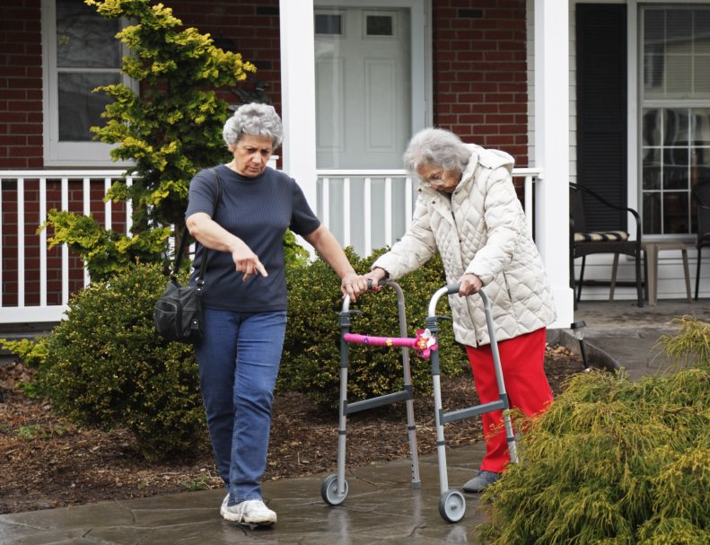
What Populations do the Waivers Serve?
HIV/AIDS
Serves people who have HIV/AIDS and are at risk for hospitalization
Mechanical Ventilator Dependent (Vent)
Serves people who are 21 years or older and dependent upon mechanical ventilation
Community Choices (CC)
Serves the frail elderly and persons with
physical disabilities who are at least age 18
who meet the nursing facility level of care criteria
Notes:
Each HCBS Waiver defines the population it will serve. This information will be helpful to you as a waiver case manager should you interact with waiver participants who may be better served in other waivers, or should you need this information to help answer questions for those who would like to participate in a waiver but are not sure which one would best meet their needs.
HIV/AIDS Waiver
This waiver serves people who have HIV/AIDS and are at risk for hospitalization
Mechanical Ventilator Dependent (Vent) Waiver
This waiver serves people who are 21 years or older and dependent upon mechanical ventilation
Community Choices (CC) Waiver
This waiver serves the frail elderly and persons with physical disabilities who are at least age 18 who meet the nursing facility level of care criteria

Slide 21

Waiver Population
Medically Complex Children (MCC)
Hospital Level of Care
Chronic physical/health condition
Medical eligibility criteria
Notes:
This waiver serves children who meet the hospital level of care and have a chronic physical or health condition expected to last longer than 12 months.
The participants must also meet the State-defined medical eligibility criteria which evaluate the child’s dependency on medications, hospitalizations, skilled nursing services, ancillary services and specialist.

Slide 22

Waiver Population (Cont’d)
Palmetto Coordinated System of Care (PCSC)
Hospital Level of Care
Behavioral Health Challenges
Co-occurring Conditions
Notes:
The Palmetto Coordinated System of Care Waiver, also known as the PCSC Waiver, provides services to participants up to age 21 meeting hospital level of care, who would otherwise be served in inpatient general and psychiatric hospitals. This waiver serves Medicaid-eligible children and youth up to age 21 with significant behavioral health challenges or co-occurring conditions in or at imminent risk of out-of-home placement. The waiver is operated by the South Carolina Continuum of Care (COC), a division of the South Carolina Department of Administration.

Slide 23



Waiver Population (Cont’d)
Head and Spinal Cord
Injury (HASCI)
Intellectual Disability/
Related Disabilities (ID/RD)
Community Supports (CS)
Notes:
The Head and Spinal Cord Injury Waiver, also known as the HASCI Waiver, serves persons with traumatic brain injury, spinal cord injury or both, or a similar disability not associated with the process of a progressive degenerative illness, disease, dementia or a neurological disorder related to the aging.
All persons must meet either the Nursing Facility level of care or the Intermediate Care Facility for Individuals with Intellectual Disabilities (ICF-IID) level of care criteria.
Participants must be enrolled prior to age 65 but will remain eligible for Waiver services after their 65th birthday if all other eligibility factors continue to be met.
The Intellectual Disability/Related Disabilities Waiver, also known as the ID/RD Waiver, serves people with intellectual disabilities and related disabilities who meet the ICF-IID level of care criteria. There is no age restriction for this waiver.
The Community Supports Waiver, also known as the CS Waiver, serves people with intellectual disabilities or related disabilities whose waiver service needs will not exceed a certain dollar amount per year, as defined by the CMS-approved waiver document. All participants must meet ICF-IID Level of Care criteria. There is no age restriction for this waiver.
Information on these three (3) waivers listed above will be provided in later modules.

Slide 24

Waiver Case Manager Expectations
YOU
Institutional Care
vs.
Home and Community
Based Services
Assessments
Service Plans
Ongoing
monitoring
Level of Care
Notes:
A waiver case manager is responsible for coordinating services for waiver participants to assure that they have access to a full array of needed waiver and other State Plan services, including appropriate medical, social, educational or other needed services.
To do this, a waiver case manager must:
Initiate or conduct the process for determining the individual’s Level of Care,
Conduct assessments and create responsive and appropriate service plans for individuals,
Document the individual’s choice between institutional care or home and community-based services, and
Provide ongoing monitoring of services outlined in the service plan.
Waiver case managers are responsible for many activities and those will be detailed in later modules.
In short, a waiver case manager connects the waiver participants with the services they need to support them living at home or in their community.

Slide 25





Waiver Case Manager Expectations (Cont’d)
Learn and know the population you serve
Be professional
Do’s and Don’ts
Great service
Family
Notes:
As with any professional position, there are expectations that your Supervisor, your employer, SCDDSN, SCDHHS or CMS has of you in this position.
You may get more direction and training from your Supervisor on expectations, but here are some that you should be aware of.
First, learn about and know the population you serve!
Be Professional. This includes:
-Being responsive to the waiver participants’ needs
-Dressing appropriately when visiting waiver participants
-Being on time for your appointments with waiver participants
-Returning phone calls in a timely manner
-Setting appropriate boundaries with waiver participants and their families
-Following all documentation requirements and
-Keeping up your knowledge base to better perform your duties through training and other self-directed learning
Understand what you can – and cannot - do in your role, be able to explain that to waiver participants and know when to say no!
Provide service in a manner that promotes dignity and respect, health, safety and well-being, individual and family participation, choice control and responsibility, relationships with family and friends and community connections, personal growth and accomplishment, and provide service that is person-centered, responsive, efficient, and accountable.
Finally, understand Medicaid abuse and fraud so you can avoid it or report it.
It is expected that you will perform all the duties required of a waiver case manager as outlined in the Waiver Document.
More information on that will be in later modules as well as be supplemented by your Supervisor.

