Slide 1
Level of Care – Head and Spinal Cord Injury (HASCI) Waiver
Version 1.0 (07/01/20)
Notes:
This module will review Level of Care evaluations for the Head and Spinal Cord Injury Waiver.

Slide 2
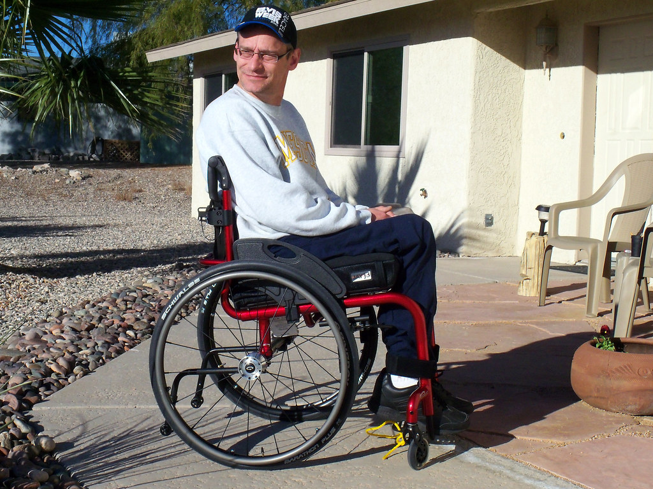
HASCI Waiver Enrollment
Eligible for Placement
Nursing Facility
ICF/IID
Certified within at least 30 days
"A sunny day in Arizona" by akfoto is licensed under CC BY-SA 2.0
Notes:
To be eligible for enrollment in the Head and Spinal Cord Injury, or HASCI Waiver, a person must be otherwise eligible for placement in a Nursing Facility (NF) or an Intermediate Care Facility for Individuals with Intellectual Disability (ICF/IID). A person must be certified to meet Level of Care (LOC) criteria for NF or ICF/IID within at least 30 days prior to initial enrollment or re-enrollment in the HASCI Waiver.

Slide 3
Nursing Facility (NF) LOC Initial Determination
SCDHHS - LTL Division
Referral
Notes:
For new enrollment or re-enrollment in the HASCI Waiver, the Waiver Case Manager must request a Level of Care from South Carolina Department of Health and Human Services Division of Long-Term Living to determine if the person meets Nursing Facility Level of Care. This is done by first submitting an electronic referral through the Long-Term Living Centralized Intake using the Phoenix portal.
If the Waiver Case Manager is unable to upload this information to the Phoenix Portal, he/she must mail or fax these supporting documents to the appropriate Long-Term Living Area Office serving the locality where the person resides.
See the HASCI Waiver Manual for recommended information to upload and include in the Level of Care referral.

Slide 4
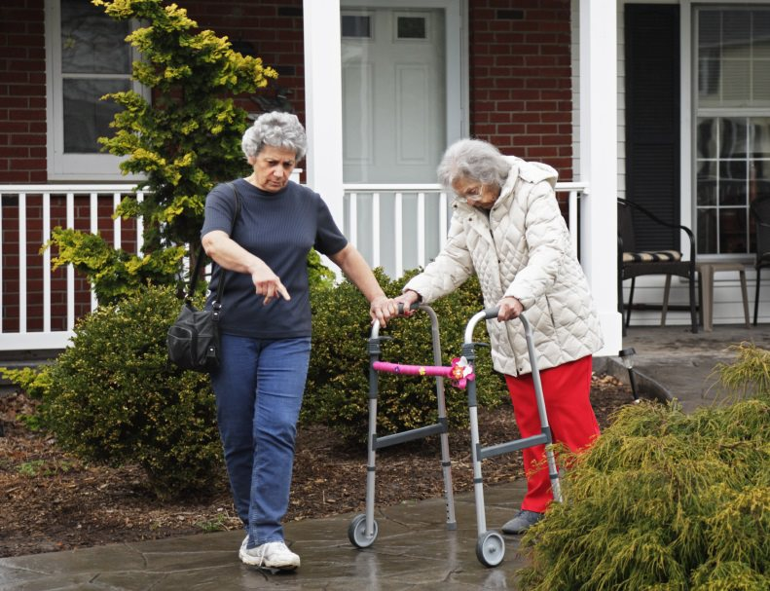
NF Level of Care
Reminder:
Schedule NF LOC
Re-determination
Documentation
Information
WCM
Direct Observation
Notes:
The Nursing Facility Level of Care is re-evaluated by the Waiver Case Manager using recommended documentation, information provided by the participant and/or representative, and direct observation of the participant. The information is then used to determine if there is a change and/or improvement in functioning that may affect Nursing Facility Level of Care status. Re-determinations are to be done within 365 calendar days of the prior LOC determination and scheduled within enough time to allow consultation with the HASCI Division, if necessary. It is the responsibility of the Waiver Case Manager or Supervisor to monitor the LOC of each HASCI waiver participant, and to ensure the certification does not expire.

Slide 5
ICF/IID LOC Initial Determination
SCDDSN Eligibility
Division
Level of
Care
Results
Notes:
For new enrollment or re-enrollment in the HASCI waiver, the South Carolina Department of Disabilities and Special Needs, or SCDDSN, Eligibility Division makes the initial determination of ICF/IID Level of Care. The Waiver Case Manager must complete an initial Level of Care and submit it to the SCDDSN Eligibility Division for approval.
Once the information is received, The SCDDSN Eligibility Division will review the information. When the Level of Care determination has been made, the SCDDSN Eligibility Division will notify the Waiver Case Manager of the results.

Slide 6
Level of Care Re-determination
365
Calendar Days
Re-assessed
Re-determined
Notes:
For continued participation in the HASCI Waiver, the waiver participant’s Level of Care must be formally re-assessed and re-determined at least within every 365 calendar days. It is the responsibility of the Waiver Case Manager or Supervisor to monitor the Level of Care certification of each HASCI Waiver participant, and to ensure the certification does not expire.

Slide 7
ICF/IID or NF Level of Care
10
Calendar Days
“You no longer meet Level of Care”
Notes:
If the participant no longer meets ICF/IID or NF Level of Care, the Waiver Case Manager must inform the participant or legal guardian of the determination and inform them that he/she will be terminated from the HASCI Waiver effective 10 calendar days after date of the notice. Appeal Rights must also be provided along with the notice.
See the HASCI Waiver Manual for more specific information relating to Re-determinations.

Slide 8
Conclusion
Notes:
This concludes the HASCI Waiver Level of Care annual training. Please see your Supervisor for any questions or concerns.

Slide 9
Version 1.0 (07/01/20)

